Slide 1
COMP 360: Section 1, Computer Networks Lecture 7: Introduction to Python
Victoria Manfredi
vumanfredi@wesleyan.edu
September 27, 2016

Slide 2
What is python?
An object-oriented, interpreted programming language
created by a Monty Python fan
https://www.python.org
Interpreted
i.e., interpreter executes code, no compilation needed
python disclaimer: you don’t need to compile the .py files, but there is still an intermediate stage of compiling to byte code before interpreting that you won’t see
Pros
platform independent, easy to learn, good for prototyping a system
typed objects, un-typed variable names
Cons
slower program run-time
dynamic types: discovered at runtime

Slide 3
Getting started
Very likely python already installed on your machine
type python in terminal
Check Python version
type “python --version” in terminal
we’ll be using Python 3.x
if Python 3.x installed, you should be able to type python3 in terminal
Different ways to obtain Python 3.x
https://www.python.org/downloads/
ubuntu
sudo apt-get install python3
anaconda distribution
contains many useful packages/modules, including ipython
https://www.continuum.io/downloads

Slide 4
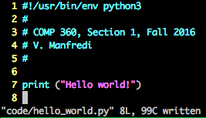
Two ways to use python
Python interpreter
type python at terminal prompt to open interpreter. Then type code at resulting python prompt
useful for understanding and testing (small bits of) python code
Save python code to file (module) and execute the file
# sign is used for comments, first line tells interpreter to use first python in your $PATH variable on UNIX

Slide 5
Good to know
ipython
https://ipython.org/install.html
a better python command line shell
tab auto-completion of object functions
Python style guide
https://google.github.io/styleguide/pyguide.html
Making your editor work nicely with python
https://wiki.python.org/moin/Vim
https://www.emacswiki.org/emacs/PythonProgrammingInEmacs
https://marketplace.eclipse.org/content/pydev-python-ide-eclipse

Slide 6
Reference and tutorials
Python homepage
https://www.python.org/
Python documentation
https://docs.python.org/3/
Many, many tutorials
https://docs.python.org/3/tutorial/index.html
http://www.tutorialspoint.com/python3/index.htm

Slide 7
https://en.wikipedia.org/wiki/Zen_of_Python
Beautiful is better than ugly.
Explicit is better than implicit.
Simple is better than complex.
Complex is better than complicated.
Flat is better than nested.
Sparse is better than dense.
Readability counts.
Special cases aren't special enough to break the rules.
Although practicality beats purity.
Errors should never pass silently.
Unless explicitly silenced.
In the face of ambiguity, refuse the temptation to guess.
There should be one— and preferably only one —obvious way to do it.
…

Slide 8
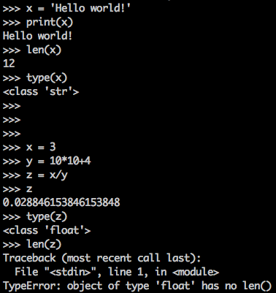
Readability counts
No explicit declaration of variable type
determined based on value assigned to variable
memory allocated when variable assigned
memory deallocated when variable no longer in scope
No brackets {} or ;
use white-space indentation instead
4 spaces equals 1 level of indentation (1 tab)

Slide 9
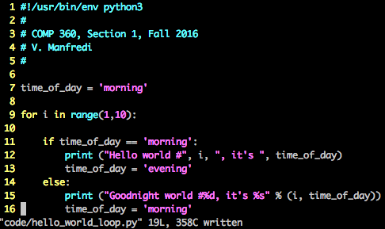
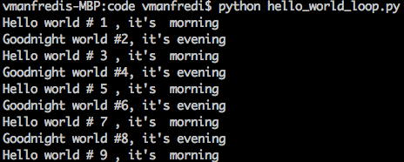
If/then and loops
https://docs.python.org/3/tutorial/controlflow.html

Slide 10
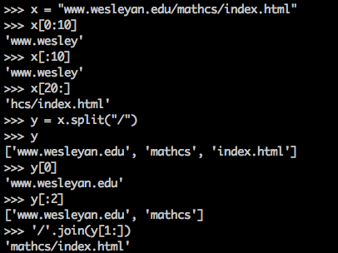
Strings
Easy to create and use
many functions to search and manipulate strings
https://docs.python.org/3/library/string.html

Slide 11
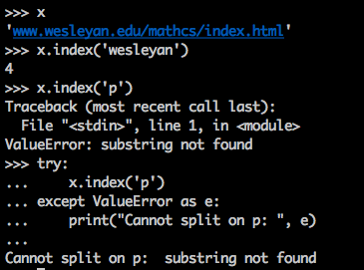
String exceptions
string.index(sub-string)
find index where sub-string begins, return value error if not found

Slide 12
Strings and networks
Carriage return, new line string: ‘\r\n’
as found in HTTP requests and responses
Sockets send and receive binary data
useful to be able to convert between binary and text strings
binary: socket readable
text: human readable
string prefixed with ’b’ indicates that it’s binary
UTF-8 (Unicode Transformation Format – 8 bit)
https://en.wikipedia.org/wiki/UTF-8
binary encoding, backward compatibility with ascii
able to encode all unicode characters
used by over 87% of web-pages

Slide 13
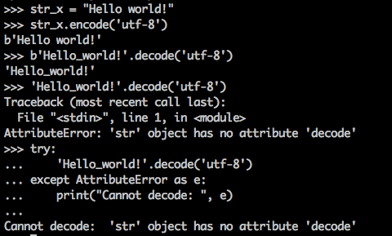
Encoding and decoding with UTF-8
https://docs.python.org/3/howto/unicode.htm

Slide 14
Endianness
Big endian
big end first: largest byte first
Little endian
little end first: smallest byte first
Network byte order
big endian
UTF-8 byte order
stays the same regardless of endian-ness
i.e., you shouldn’t need to worry about byte order

Slide 15
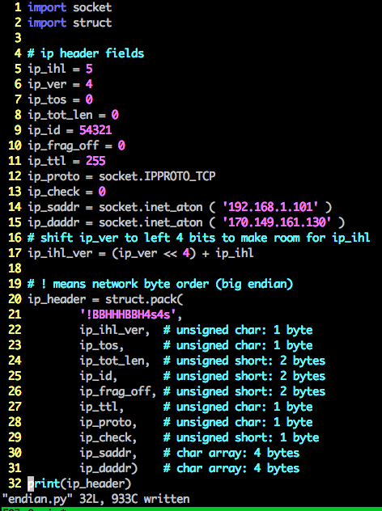
Struct module
Useful for creating packet headers
which are not utf-8 and byte order matters
Bit operations
https://wiki.python.org/moin/BitwiseOperators
Packing bytes using struct.pack
https://docs.python.org/3/library/struct.html

Slide 16
Regular expressions
More effective ways to search and manipulate strings
https://docs.python.org/3/library/re.html
Import regular expression module (re) to use
import re
Example functionality
re.search: find first location of pattern in string
re.sub: replace occurrences of pattern in string with another string
re.split: split string according occurrences of pattern

Slide 17
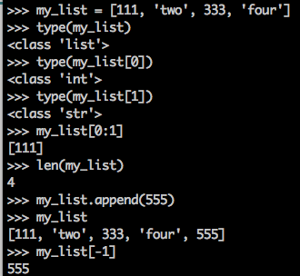
Lists
No arrays in python, use lists
https://docs.python.org/3/tutorial/datastructures.html

Slide 18
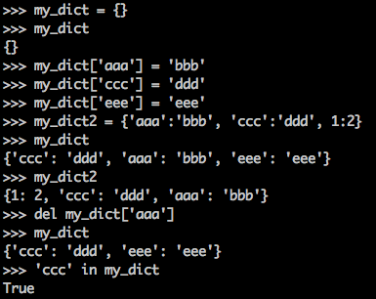
Dictionaries
Like an associative array
set of key:value pairs
Dictionary operations
create a dictionary
insert key:value pair
update value for key
Given key, return value
delete key
Indexed by (unique) keys
any immutable type
strings, numbers, tuples, frozen sets…

Slide 19
Naming conventions
Python identifier
name identifying variable, function, class, module
Is identifier for a class?
begin identifier with uppercase letter
Is identifier for anything else?
begin identifier with lowercase letter
Is identifier private?
begin identifier with one leading underscore

Slide 20
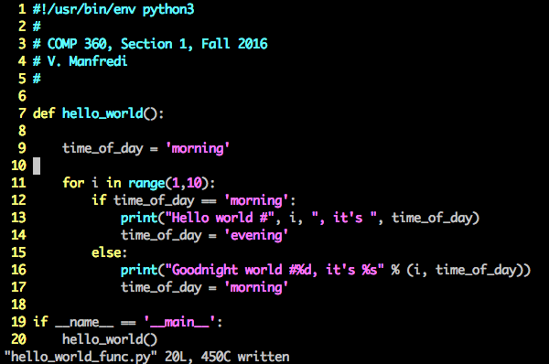
Functions
Execute code in file (the module) as program
If no main: don’t execute but can include file as module in other files

Slide 21
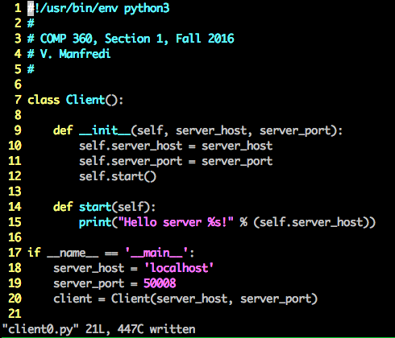
Classes
Class constructor, called automatically
self refers to current class instance
Instantiate class

Slide 22
Functions vs. Methods
Function
operations not associated with classes
hello_world() is function
Method
operations associated with classes
__init__() and start() are methods

Slide 23
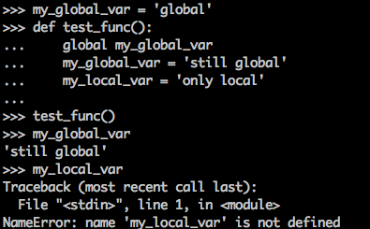
Scoping
Local variables
all the variables we’ve seen so far
Global variables
declare using global keyword

Slide 24
Modules
Python .py file or set of files containing code
a file containing a bunch of functions you wrote
a file containing a class definition
Package
a collection of modules
Many, many open-source packages out there
Numpy, SciPy, Pandas, Twisted, Matplotlib, NetworkX
What python packages are installed on your machine?
type help(“modules”) at python prompt
or use pip
sudo apt-get install python-pip
pip freeze

Slide 25
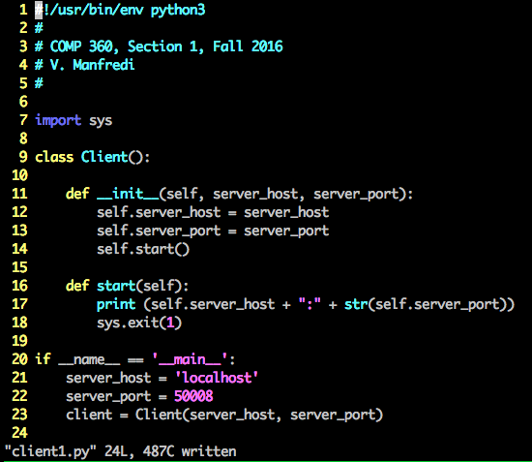
Importing a module

Slide 26
Importing a module variations
Import all sub-modules from modules
from struct import *
struct.join() becomes join()
Shorten module name
import http_util as util
Importing your own module follows the same rules

Slide 27
Wrap-up
Download and install Python 3.x
familiarize yourself with python, play with examples
Easy to find out more about python capabilities
https://www.python.org
Code snippets from today
http://vumanfredi.web.wesleyan.edu/2016/COMP360/lectures/code/

