Slide 1
COMP 360: Section 1, Computer Networks Lecture 2: History of Networks
Victoria Manfredi
vumanfredi@wesleyan.edu
September 8, 2016

Slide 2
COMPUTER NETWORKING
1960s to Today

Slide 3
1960s to 1980s
1961: Kleinrock publishes packet-switching work
1967: ARPAnet is born (the forerunner of Internet)
1969: ARPAnet has one node
1970: ALOHANet is born (microwave network in Hawaii)
many other networks being created during this decade as well
1972: ARPAnet has 15 nodes
1972: Ray Tomlinson creates first email program
1973: Cerf and Kahn coin the term “Internet”
enough networks that can think about “internetworking of networks”
1974: Cerf and Kahn create TCP
1976: Metcalfe and Boggs create the Ethernet protocol
1979: ARPAnet has 200 nodes online
Author of the Internet is for Everyone

Slide 4
ARPAnet in 1977

Slide 5
1980s to 2000s
1983: TCP/IP deployed in ARPAnet
1982: SMTP: Simple Mail Transfer Protocol created
1983: DNS: Domain Name System created
1986: NSFNET is born
1988: TCP gets congestion control
1988: Morris worm: one of first Internet worms
1989-1991: Berners-Lee creates the World Wide Web
1992: Around 200 web servers online
1995: Microsoft’s Internet Explorer is born
1997: google.com domain is registered by Page and Brin
1999: Napster created: peer to peer file sharing

Slide 6
2000s to Today
2001: BitTorrent created
2004: Facebook launched
2004: Birth of botnets
2005: YouTube created
2006: Amazon’s Elastic Compute Cloud (EC2) is born
2008: Google indexing hits 1 trillion URLs on the web
2010: Facebook has 400 million users
2012: Syria shuts off the Internet
2014: 64% of web traffic is video
2014: Turkey reroutes DNS requests to block social networks
2016: China launches the first quantum satellite

Slide 7
DIFFERENT VIEWS OF NETWORKS

Slide 8
Internet evolution
Number of hosts on the Internet
By Kopiersperre (Own work) [CC BY-SA 3.0 (http://creativecommons.org/licenses/by-sa/3.0) or GFDL (http://www.gnu.org/copyleft/fdl.html)], via Wikimedia Commons

Slide 9
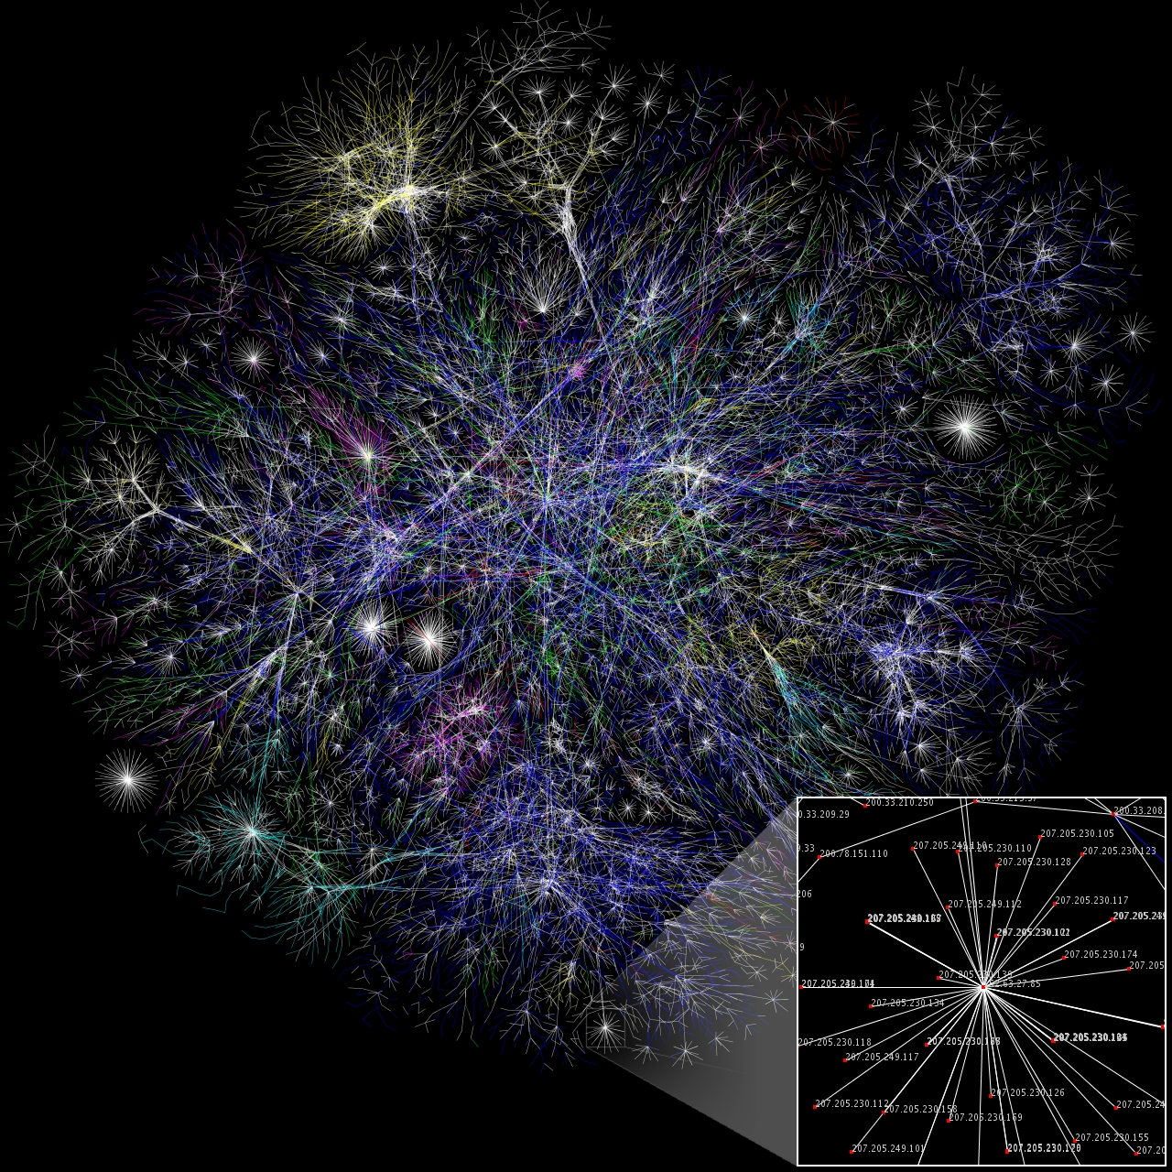
Internet map
Who is connected to whom?
Nodes: IP addresses
Edges: lengths are delay
By The Opte Project [CC BY 2.5 (http://creativecommons.org/licenses/by/2.5)], via Wikimedia Commons
Notes:
Biological network: Nodes are metabolites, links are biochemical relationships
From wikipedia: “metabolites are the intermediates and products of metabolism. The term metabolite is usually restricted to small molecules”

Slide 10
Internet usage
Internet users per 100 inhabitants
By Jeff Ogden (W163) - Own work, CC BY-SA 3.0, https://commons.wikimedia.org/w/index.php?curid=18972898

Slide 11
At the Amsterdam IXP
Optical fiber patch panel connecting different ISPs
By Fabienne Serriere [CC BY-SA 3.0 (http://creativecommons.org/licenses/by-sa/3.0)], via Wikimedia Commons

Slide 12
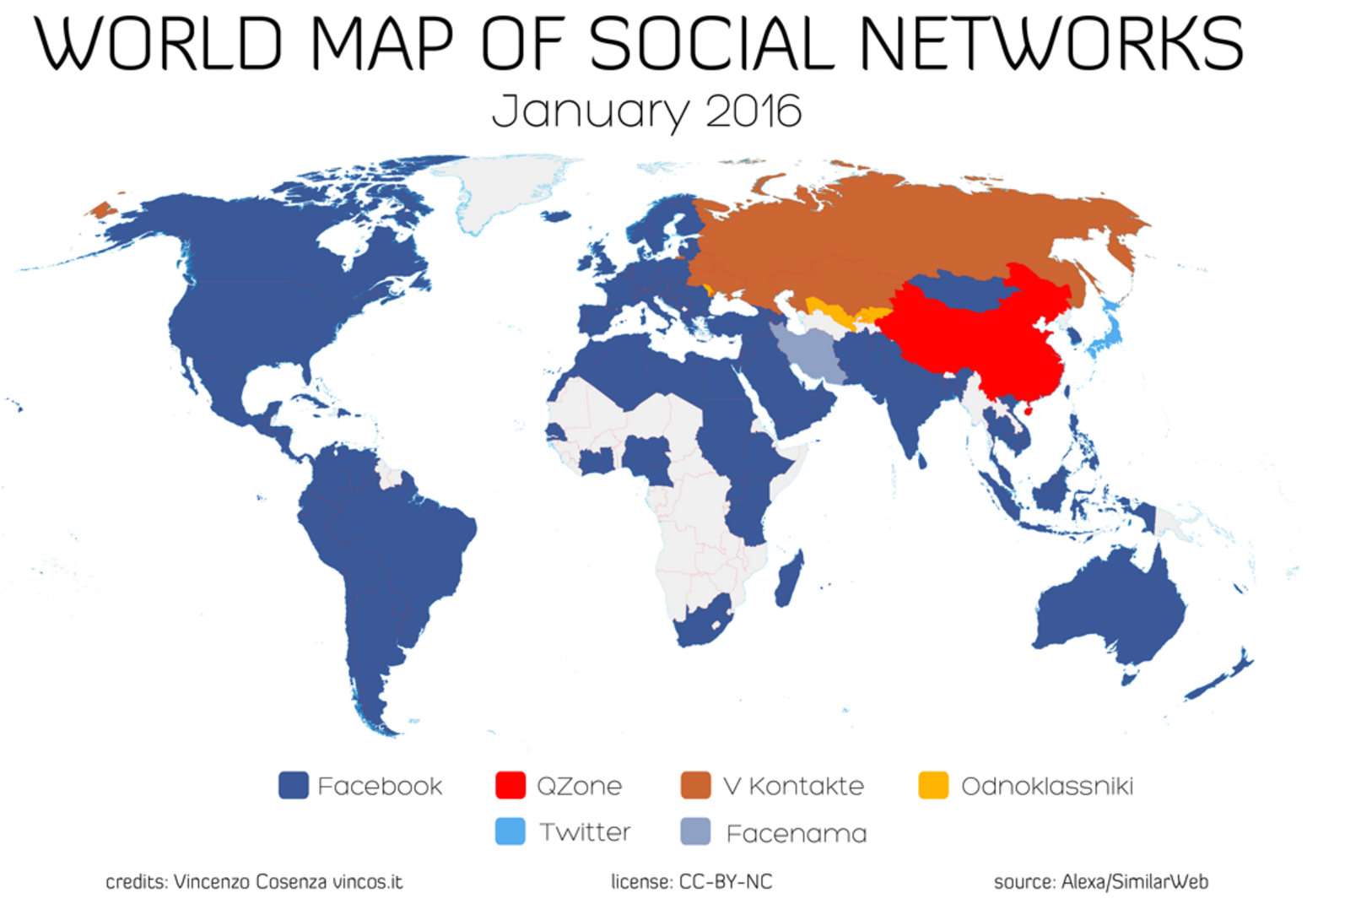
Social networking
http://vincos.it/world-map-of-social-networks/

Slide 13
More social networking
http://xkcd.com/802/

Slide 14
Map of the titans
By Jay Simons (http://jaysimons.deviantart.com/art/Map-of-the-Internet-2-0-436762109)

Slide 15
Security on the Internet
Internet census of 2012 via botnet
discovered 460 million IP addresses using ICMP ping and port scans
http://internetcensus2012.bitbucket.org/paper.html

Slide 16
Anonymity on the Internet
Tor users per day per 100,000 Internet users
By Stefano.desabbata (Own work) [CC BY-SA 4.0 (http://creativecommons.org/licenses/by-sa/4.0)], via Wikimedia Commons

Slide 17
Wrap-up of Chapter 1
Whirlwind overview of networking
components of a network
how Internet is structured
packet-switching vs. circuit-switching
types of network delays
Internet protocol stack
Next class
probability review (very, very targeted to what we need)
look at some practical network tools
Going forward
dig deeper into each layer of the Internet protocol stack
start with application layer and work down to link layer

