Slide 1
COMP 360: Section 1, Computer Networks Lecture 3: Wireshark and other network tools
Victoria Manfredi
vumanfredi@wesleyan.edu
September 13, 2016

Slide 2
Roadmap
IP addresses
What’s my IP address?
What’s host’s IP address?
Network topology
Is host up?
What is path to host?
What ports are open on host?
Looking at network connections
Sending and receiving traffic over a network connection
Looking at network traffic

Slide 3
Disclaimer
Our focus in these slides is Unix-based tools. If you are a Windows aficionado, please come talk to me about finding equivalent tools for Windows.

Slide 4
Everything on the Internet has an IP address
IPv4 addresses
4 byte addresses
space of addresses: 0-255 . 0-255 . 0-255 . 0-255
hostnames are human-readable, IP addresses are machine-readable
Loopback address: send traffic to yourself
traffic sent here is “looped back” through network stack on machine on which sending process is running
127 . * .* .*
typically 127.0.0.1, also called localhost
Private subnet addresses
10 .* .* .*
172.16-31 .* .*
192.168 .* .*
We’ll cover address masks later …
IPv6 addresses
16 byte addresses: we’re running out of 4 byte addresses …
Subnet: shared prefix portion of addr

Slide 5
How are IP addresses assigned?
Your ISP or institution has a block of IP addresses
you are assigned one of those IP addresses
(it’s possible you will get a NAT’d address …)
Manually configured (static IP address)
set the necessary network info in network settings
Dynamically configured
using Dynamic Host Configuration Protocol (DHCP) in network-layer
Client (you) broadcasts request for an IP address
DHCP server on network assigns you address from pool of addresses
typically you only get ip address for a fixed period of time
a router can be configured to act as a DHCP server
More on IP addresses when we get to network layer lectures

Slide 6
Is one IP address per machine enough?
What happens if you run multiple network applications?
you will have many processes running on your computer
a process is a program in execution
How do messages received by your computer get to the right process?
messages are addressed to an (IP address, port #) pair
different processes on your computer will connect to the network using the same IP address but different port numbers

Slide 7
How do two processes talk over a network?
Via sockets: connection endpoint with associated IP addr, port #
Well-known ports: 0-1023
E.g., HTTP is port 80
Registered ports: 1023-49151
Available ports: 49152-65535
Client Process Server Process
Application layer
Transport layer
Network layer
Client Port #
Network
Server Port #
Socket
TCP or UDP
Socket
TCP or UDP
Client IP address
Server IP address

Slide 8
Actually …
Many devices on Internet have multiple IP addresses
How?
IP address is associated with network interface not machine
network interface card (NIC): connects computer to network
A machine can have 1 or more network interfaces
my laptop has (at least) 2 NICs: 1 wireless and 1 wired (via USB)
router needs at least two interfaces
otherwise can’t connect multiple networks together
Cisco core router: can have up to 10,000 interfaces!
one interface per link: router has many IP addresses
VirtualBox Virtual Machine (VM)
you need to set the number and type of network interfaces for VM
Notes:
http://www.cisco.com/c/en/us/support/docs/ios-nx-os-software/ios-software-releases-122-mainline/15096-idb-limit.html
http://aconaway.com/2010/09/03/stubby-post-whats-an-idb/

Slide 9
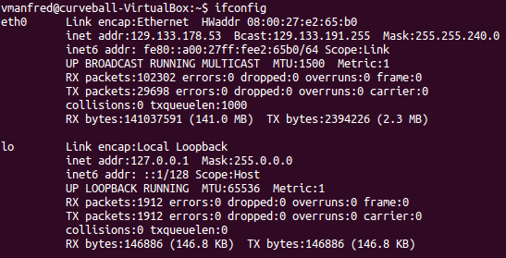
What’s my IP address?
ifconfig
what network interfaces does my machine have?
what are my IP and MAC # addresses?
configure/enable/disable an interface
Linux
Ethernet 0
IPv4 address
IPv6 address
Loopback address

Slide 10
What’s host’s IP address?
Host
What’s host name for IP address?

Slide 11
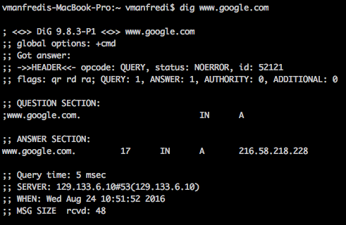
What’s host’s IP address?
dig
DNS resolver used

Slide 12
Internet Control Message Protocol (ICMP)
Used by hosts to send error messages
operates at network layer (IP)
example messages
host is unreachable
echo request (for pinging a host)
time-to-live on packet has been exceeded, packet will be dropped
packet size exceeds path Maximum Transmission Unit (MTU), fragmentation needed

Slide 13
Is host up?
Ping
sends ICMP echo request to host
host sends ICMP echo reply back
If no reply within timeout period, packet deemed lost
What happened here? Did we get a true timeout?
In this case, cs.stanford.edu isn’t actually down: only looks to be down because Wesleyan firewall blocks ICMP traffic

Slide 14
Try ping on a non-Wesleyan network
Some options
visit your favourite coffee shop and borrow some wifi
use your cell phone as an access point
use Amazon cloud
telnet to non-Wesleyan host that will let you do a traceroute
http://www.netdigix.com/servers.html
http://www.telnet.org/htm/places.htm
http://www.jumpjet.info/Offbeat-Internet/Public/TelNet/url.htm
E.g.,
telnet route-server.west.allstream.com (traceroute will work, not ping)
telnet telehack.com (ping and traceroute will work for very limited # of hosts)

Slide 15
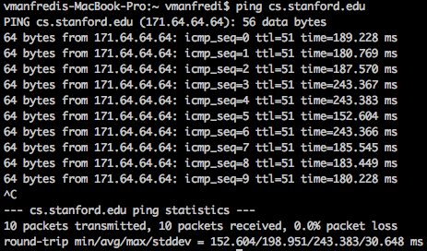
Try ping on a non-Wesleyan network

Slide 16
What’s the route my traffic takes to a host?
Traceroute
source sends UDP datagrams with increasing TTLs to destination
can also be ICMP (IP datagram) or TCP packet
every host or router that packet traverses decrements TTL by 1
hosts reply with ICMP packet when packet TTL has expired
If you want to try traceroute, you need to be on non-Wesleyan network

Slide 17
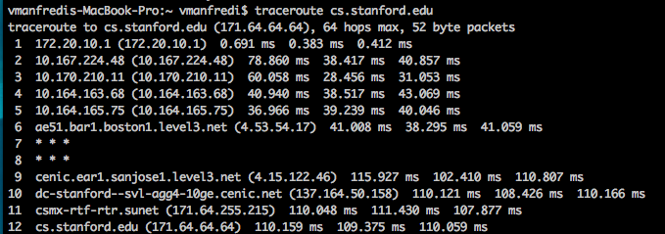
What’s the route my traffic takes to a host?
Traceroute
source sends UDP datagrams with increasing TTLs to destination
can also be ICMP (IP datagram) or TCP packet
every host or router that packet traverses decrements TTL by 1
hosts reply with ICMP packet when packet TTL has expired

Slide 18
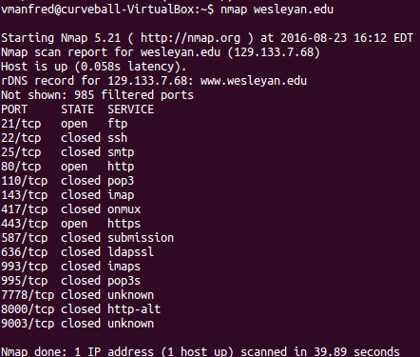
Network mapping and port scanning
Nmap
Default: send a TCP (syn) packet, if port is open, will get a TCP (syn/ack) packet back
Notes:
Uses TCP syn segments

Slide 19
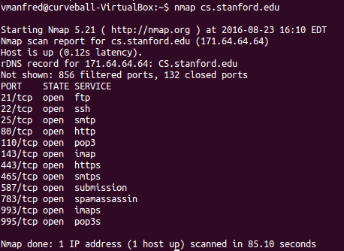
Network mapping and port scanning
Nmap
Default: send a TCP (syn) packet, if port is open, will get a TCP (syn/ack) packet back
Notes:
Uses TCP syn segments

Slide 20
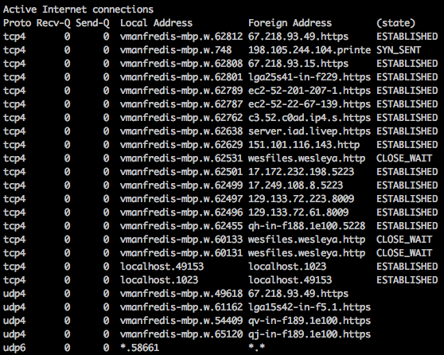
What network connections do I have?
netstat | less
IP address
Port
IP address
Port/Protocol
Protocol
state
TCP
connections
UDP
connections
Notes:
What's in the network data structures my machine is maintaining? What connections does my machine have? What ports are open?

Slide 21
What network connections do I have?
ss (socket statistics, works in linux only)
TCP connections
UDP connections
Unix connections
Notes:
What's in the network data structures my machine is maintaining? What connections does my machine have? What ports are open?

Slide 22
Sending and receiving traffic over network connection
nc: netcat, a multi-purpose network tool
Be a TCP server: listen for connections on port 51234
Be a TCP client: open connection to localhost:51234
Type a string at client and press enter
Look at the connections you created

Slide 23
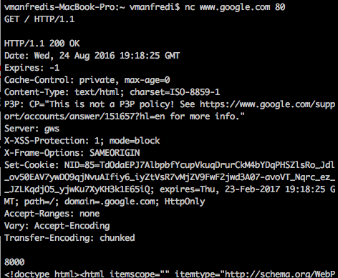
Sending and receiving traffic over network connection
Open connection to google, type HTTP request then two enters
HTTP Request
HTTP Response

Slide 24
How can I look at network traffic?
Packet sniffer
passively observes messages transmitted and received on a particular network interface by processes running on your computer
often requires root privileges to run
Popular packet sniffers
Wireshark (also command-line version, tshark)
tcpdump (Unix) and WinDump (Windows)
use command line sniffers to analyze packet traces with bash script

Slide 25
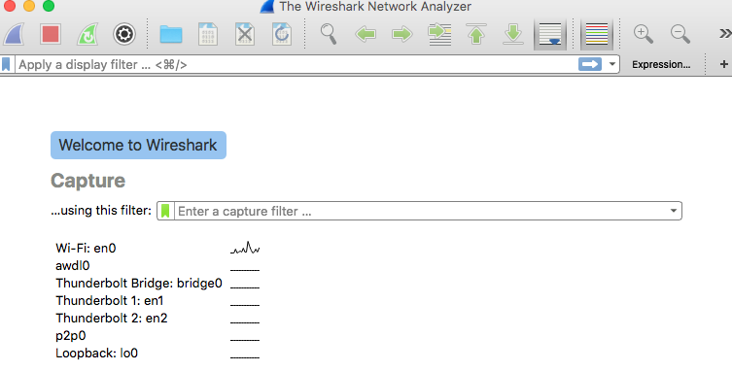
Wireshark
Install
https://www.wireshark.org/download.html
Run
type Wireshark in terminal, or double-click icon
Wireshark display may look different for Linux vs. Mac vs. Windows
Choose an interface to capture traffic on

Slide 26
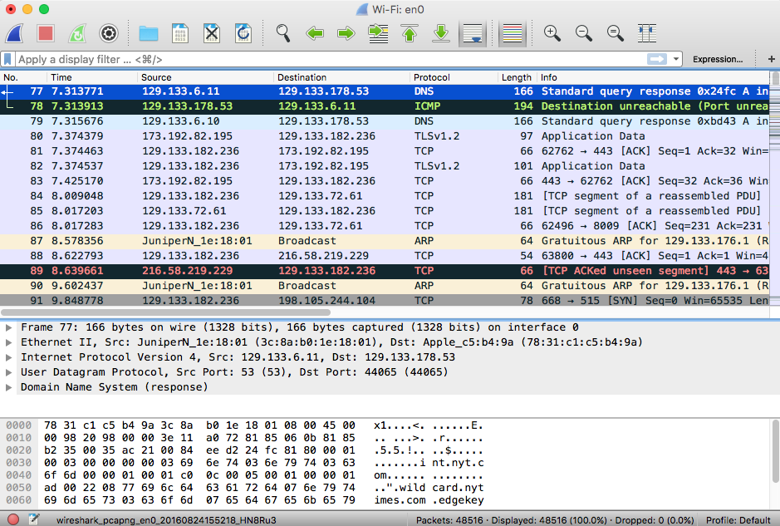
What do we see?
Display Filter
Source IP
Dest IP
Protocols
Protocol State
Captured packets
Packet details
2 hex digits = 1 byte= 1 ascii char
Packet contents in hex and ascii: can match bytes to header
If you click on pkt or header field, will highlight hex/ascii fields and vice versa

Slide 27
What do we see?
Layers
Physical
Link
Network
Transport
Application

Slide 28
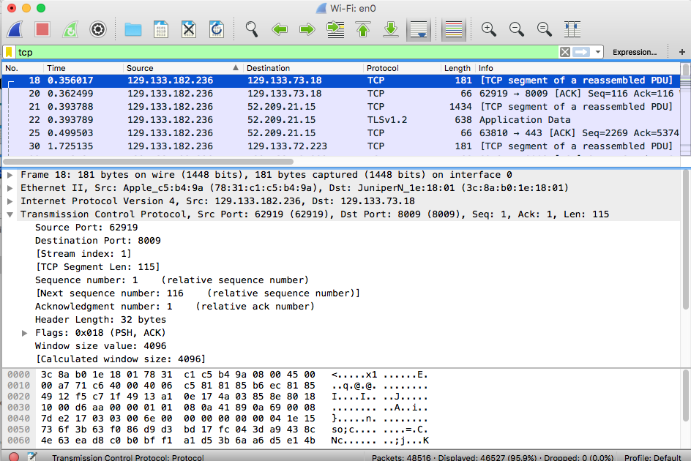
Add a filter
Only TCP traffic
See only TCP
TLS protocol runs over TCP

Slide 29
Summary
What should you remember from today’s lecture?
seeing abstract concepts discussed in class as used in practice
foreshadowing next few lectures on HTTP, DNS, and sockets
Homework assignment (handed out today)
will have you play around with traceroute and Wireshark

