Slide 1
SHARE: Scalable Hybrid Adaptive Routing for dynamic multi-hop Environments
Victoria Manfredi, Ram Ramanathan, Will Tetteh, Regina Hain, Dorene Ryder
August 6, 2017

Slide 2
Roadmap
Motivation
SHARE protocol
Evaluation
Summary

Slide 3
Roadmap
Motivation
SHARE protocol
Evaluation
Summary

Slide 4
20-50 Billion Wireless Devices by 2020 (Ericsson)
New applications across diverse networks
p2p cellphone apps
anonymous chat: bleep, briar, FireChat
smart vehicle/health/environ monitoring
Cambridge Mobile Telematics, splitsecnd
internet access
Google’s Project Loon
sharing computational power
microclouds and cloudlet
Shorter communication ranges
low power devices such as IoT
higher data rates: higher frequency bands
Parrot
Parrot
Google
Google
Rufus Labs
Notes:
New applications appearing
higher frequency bands : (e.g. mmWave)

Slide 5
20-50 Billion Wireless Devices by 2020 (Ericsson)
New applications across diverse networks
p2p cellphone apps
anonymous chat: bleep, briar, FireChat
smart vehicle/health/environ monitoring
Cambridge Mobile Telematics, splitsecnd
internet access
Google’s Project Loon
sharing computational power
microclouds and cloudlet
Shorter communication ranges
low power devices such as IoT
higher data rates: higher frequency bands
Parrot
Parrot
Google
Google
Rufus Labs
Many devices + short ranges + multiple networks ⇒ Scalable multi-hop routing protocol
Notes:
New applications appearing
higher frequency bands : (e.g. mmWave)

Slide 6
Data traffic issues in real-world wireless networks
Traffic falls off with hop-distance
[Ramanathan et al, 2010]
local traffic >> non-local traffic
Cost of route setup
local route << non-local route
Non-local destinations are often sinks
sensor networks, access points
many to one traffic
Network dynamics
mobility, congestion, wireless interference
path breaks increase with distance to destination
Design insights
Proactively maintain local link state
Reactively build network-wide gradient
Maintain multiple paths to a destination
Flood when no link or gradient state found
6
Notes:
Data traffic determines routing state needed
Redundant transmissions are valuable
Key ideas
Data traffic patterns should determine routing state needed
network traffic falls off with hop-distance so most traffic is local
proactively maintain local link state
non-local traffic often destined to a sink + topology changes are more costly for non-local destinations
worthwhile to have multiple paths to non-local destination as in a gradient
Permit redundant transmissions
wireless multi-hop networks are inherently dynamic
provide robustness against topology changes and path breaks that are more likely as distance to destination increases
flooding
braiding
wireless multi-hop networks are inherently dynamic
Node density and link breakages in a network change temporally and spatially.
Traffic traveling through a high mobility region of a network is more likely to get dropped than traffic traveling through a low mobility region.
Traffic traveling many hops to a destination is more likely to get dropped than traffic traveling just a few hops.
Traffic traveling through a highly congested region of a network is more likely to get dropped than traffic traveling through a a lightly loaded region.

Slide 7
Data traffic issues in real-world wireless networks
Traffic falls off with hop-distance
[Ramanathan et al, 2010]
local traffic >> non-local traffic
Cost of route setup
local route << non-local route
Non-local destinations are often sinks
sensor networks, access points
many to one traffic
Network dynamics
mobility, congestion, wireless interference
path breaks increase with distance to destination
Design insights
Proactively maintain local link state
Reactively build network-wide gradient
Maintain multiple paths to a destination
Flood when no link or gradient state found
7
Notes:
Data traffic determines routing state needed
Redundant transmissions are valuable
Key ideas
Data traffic patterns should determine routing state needed
network traffic falls off with hop-distance so most traffic is local
proactively maintain local link state
non-local traffic often destined to a sink + topology changes are more costly for non-local destinations
worthwhile to have multiple paths to non-local destination as in a gradient
Permit redundant transmissions
wireless multi-hop networks are inherently dynamic
provide robustness against topology changes and path breaks that are more likely as distance to destination increases
flooding
braiding
wireless multi-hop networks are inherently dynamic
Node density and link breakages in a network change temporally and spatially.
Traffic traveling through a high mobility region of a network is more likely to get dropped than traffic traveling through a low mobility region.
Traffic traveling many hops to a destination is more likely to get dropped than traffic traveling just a few hops.
Traffic traveling through a highly congested region of a network is more likely to get dropped than traffic traveling through a a lightly loaded region.

Slide 8
Data traffic issues in real-world wireless networks
Traffic falls off with hop-distance
[Ramanathan et al, 2010]
local traffic >> non-local traffic
Cost of route setup
local route << non-local route
Non-local destinations are often sinks
sensor networks, access points
many to one traffic
Network dynamics
mobility, congestion, wireless interference
path breaks increase with distance to destination
Design insights
Proactively maintain local link state
Reactively build network-wide gradient
Maintain multiple paths to a destination
Flood when no link or gradient state found
8
Notes:
Data traffic determines routing state needed
Redundant transmissions are valuable
Key ideas
Data traffic patterns should determine routing state needed
network traffic falls off with hop-distance so most traffic is local
proactively maintain local link state
non-local traffic often destined to a sink + topology changes are more costly for non-local destinations
worthwhile to have multiple paths to non-local destination as in a gradient
Permit redundant transmissions
wireless multi-hop networks are inherently dynamic
provide robustness against topology changes and path breaks that are more likely as distance to destination increases
flooding
braiding
wireless multi-hop networks are inherently dynamic
Node density and link breakages in a network change temporally and spatially.
Traffic traveling through a high mobility region of a network is more likely to get dropped than traffic traveling through a low mobility region.
Traffic traveling many hops to a destination is more likely to get dropped than traffic traveling just a few hops.
Traffic traveling through a highly congested region of a network is more likely to get dropped than traffic traveling through a a lightly loaded region.

Slide 9
Roadmap
Motivation
SHARE protocol
Evaluation
Summary

Slide 10
SHARE
Scalable Hybrid Adaptive Routing for dynamic multi-hop Environments
new approach to scalable multi-hop routing
Key components
Proactive link state routing
local traffic: < 2 hops
Reactive gradient routing
non-local traffic: > 2 hops
probabilistically truncate gradient control traffic to reduce overhead
Replication of data packets (“braiding”)
for robustness against topology changes
Flooding (only as long as necessary)
when no gradient or link state found

Slide 11
SHARE
Scalable Hybrid Adaptive Routing for dynamic multi-hop Environments
new approach to scalable multi-hop routing
Key components
Proactive link state routing
local traffic: < 2 hops
Reactive gradient routing
non-local traffic: > 2 hops
probabilistically truncate gradient control traffic to reduce overhead
Replication of data packets (“braiding”)
for robustness against topology changes
Flooding (only as long as necessary)
when no gradient or link state found

Slide 12
Reactive gradient routing
On-demand network wide gradient
for packets with non-local destinations
gradient gives cost to destination
e.g., hop count
reduces need for state correctness
provides ready-made backup routes
Components
Gradient establishment
should be built rarely since non-local traffic should be rare
Gradient seeking
flood packet until link state, gradient state, or destination found
Source
5
5
4
4
4
4
5
4
3
4
4
3
3
3
2
3
3
2
2
4
2
1
3
2
1
Destination

Slide 13
Reactive gradient routing
On-demand network wide gradient
for packets with non-local destinations
gradient gives cost to destination
e.g., hop count
reduces need for state correctness
provides ready-made backup routes
Components
Gradient establishment
should be built rarely since non-local traffic should be rare
Gradient seeking
flood packet until link state, gradient state, or destination found
Source
5
5
4
4
4
4
5
4
3
4
4
3
3
3
2
3
3
2
2
4
2
1
3
2
1
Destination

Slide 14
Gradient establishment
GEM
Gradient Establishment Message
contains hop count, time generated
destination triggers GEM generation
Recipients of GEM
record and increment hop-count
re-broadcast if most recent timestamp for destination and lowest hop-count
Further limit GEMs generated
adaptive GEM generation rates
higher rate if node receiving traffic destined to it
truncate scope of GEM flood
probabilistic, density-adaptive approach
Source
5
5
4
4
4
4
5
4
3
4
4
3
3
3
2
3
3
2
2
4
2
1
3
2
1
Destination
Notes:
Adaptive GEM sending rate
low background rate at which all nodes send GEMs
higher “normal” rate that is triggered as long as a node receives data packets destined for itself and the source of the data packet is not in the destination’s 2-hop link state. A node reduces its GEM rate when it has received no data traffic destined to itself for a threshold period of time.

Slide 15
Gradient establishment
GEM
Gradient Establishment Message
contains hop count, time generated
destination triggers GEM generation
Recipients of GEM
record and increment hop-count
re-broadcast if most recent timestamp for destination and lowest hop-count
Further limit GEMs generated
adaptive GEM generation rates
higher rate if node receiving traffic destined to it
truncate scope of GEM flood
probabilistic, density-adaptive approach
Source
5
5
4
4
4
4
5
4
3
4
4
3
3
3
2
3
3
2
2
4
2
1
3
2
1
Destination
Notes:
Adaptive GEM sending rate
low background rate at which all nodes send GEMs
higher “normal” rate that is triggered as long as a node receives data packets destined for itself and the source of the data packet is not in the destination’s 2-hop link state. A node reduces its GEM rate when it has received no data traffic destined to itself for a threshold period of time.

Slide 16
Truncating the flood of GEMs
Node w broadcasts GEM
Node v determines whether to retransmit
v wants its u_{i} neighbors to each receive C GEMs
for gradient path diversity
v uses local link state to compute retransmission probability
w
GEM
v x₁ x₂ x₃
GEM
u₁ u₂ u₃ u₄
Notes:
Node v retransmits a GEM based on the number of w’s 1-hop neighbors that cover each of v’s 1-hop neighbors, excluding w.
⇒ w’s 1-hop neighbors excluding v that cover u
if a node receives a broadcast packet, it knows which of its neighbors should also have received the packet
C : desired number of nodes “covering” a 1-hop neighbor
C controls extent to which a packet is flooded
node computes minimum probability, p, that any 1-hop neighbor receives GEM if it does not retransmit
p is computed from link state : each node knows its 1- hop and 2-hop neighborhoods.
Our retransmission must cater to the node that is least covered by nodes with the packet from w.
Set of forwarders is controlled so that every node gets GEM from sufficient (e.g. 3 to 4) neighbors so that they have some alternate paths, but not from every neighbor
By probabilistically truncating GEM floods, SHARE intelligently reduces the effective degree of the network thereby reducing the bandwidth incurred by flooded messages.
Scoping GEM floods has the effect of controlling the number of alternate paths of which a node is aware. However, the probabilistic nature of the retransmissions ensures that from one GEM flood to the next, different nodes will probabilistically respond, ensuring in expectation that over multiple floods that all available alternate paths will be found.
The case C ≥ |Cmin| might occur because there are insufficient nodes to cover the 1-hop neighbor, or because the link-state tables have not yet converged or are out of date. Regardless, the correct behavior is still to retransmit the GEM with pR(v) = 1.

Slide 17
Truncating the flood of GEMs
Node w broadcasts GEM
Node v determines whether to retransmit
v wants its u_{i} neighbors to each receive C GEMs
for gradient path diversity
v uses local link state to compute retransmission probability
w
GEM
v x₁ x₂ x₃
GEM
u₁ u₂ u₃ u₄
C₁=2 C₂=1 C₃=1 C₄=2
C_{i} : # of GEMs each u_{i} receives if v does not retransmit
C_{min} : smallest C_{i}
v retransmits with probability
1 if C ≥ C_{min}
C / C_{min} otherwise
Notes:
Node v retransmits a GEM based on the number of w’s 1-hop neighbors that cover each of v’s 1-hop neighbors, excluding w.
⇒ w’s 1-hop neighbors excluding v that cover u
if a node receives a broadcast packet, it knows which of its neighbors should also have received the packet
C : desired number of nodes “covering” a 1-hop neighbor
C controls extent to which a packet is flooded
node computes minimum probability, p, that any 1-hop neighbor receives GEM if it does not retransmit
p is computed from link state : each node knows its 1- hop and 2-hop neighborhoods.
Our retransmission must cater to the node that is least covered by nodes with the packet from w.
Set of forwarders is controlled so that every node gets GEM from sufficient (e.g. 3 to 4) neighbors so that they have some alternate paths, but not from every neighbor
By probabilistically truncating GEM floods, SHARE intelligently reduces the effective degree of the network thereby reducing the bandwidth incurred by flooded messages.
Scoping GEM floods has the effect of controlling the number of alternate paths of which a node is aware. However, the probabilistic nature of the retransmissions ensures that from one GEM flood to the next, different nodes will probabilistically respond, ensuring in expectation that over multiple floods that all available alternate paths will be found.
The case C ≥ |Cmin| might occur because there are insufficient nodes to cover the 1-hop neighbor, or because the link-state tables have not yet converged or are out of date. Regardless, the correct behavior is still to retransmit the GEM with pR(v) = 1.

Slide 18
How SHARE nodes forward a packet
Decision loop:
Step 1. Check link state table
if destination present, use specified next hop
Step 2. Check gradient table
if destination present, use specified next hop
for additional redundancy, replicate (“braid”) data packets
Step 3. Flood (only as long as necessary)
if destination not in link state or gradient table, or TTL=0
once state is found, flooded packet switches to unicast
triggers GEMs: future packets should use gradient state
Source
∞
∞
∞
∞
3
4
3
3
3
2
3
3
2
2
4
2
1
3
2
1
Destination
Notes:
What happens if the network is partitioned with source and dest in different partitions. The source will keep on flooding. A simple fix is to time out on floods if we don't get gradient or link-state soon...
after a flood, the destination will immediately generate a GEM and switchover to fast GEMs so that very few floods should happen.
Benefits
fallback mechanism when no link or gradient state for destination
enables mechanism for network wide broadcast
allows new nodes to easily join network and start forwarding data
provides redundancy for important transmissions when desired

Slide 19
Roadmap
Motivation
SHARE protocol
Evaluation
Summary

Slide 20
Evaluation
Implemented using ns-3.22 DCE framework
same network-layer code can directly run on hardware
very high fidelity limits size of networks to ~70 nodes
802.11 with RangePropagation of R = 630 m
Scenarios
√N×√N Stationary Grid
each grid square is R × R
Gauss-Markov mobility
BonnMotion to generate traces, ignore first 3600 s
nodes distributed within M × M area
M = N R 2π / D where N is # of nodes and D = 10 is node density
Traffic patterns
many-to-one: representative of target applications like IoT and 5G
Notes:
Following previous work: packet size is 64 bytes
simulations length180 s long, traffic starts at 30 seconds and ends at 150 seconds.
Our simulation sizes are also limited due to the amount of traffic in the network: every node in the network communicates with at least one other node, resulting in correspondingly more flows as the network size increases.
Traces let SHARE and OLSR operate on same topology
Rangepropagation ensures that for the grid, the topology really conforms to a grid.

Slide 21
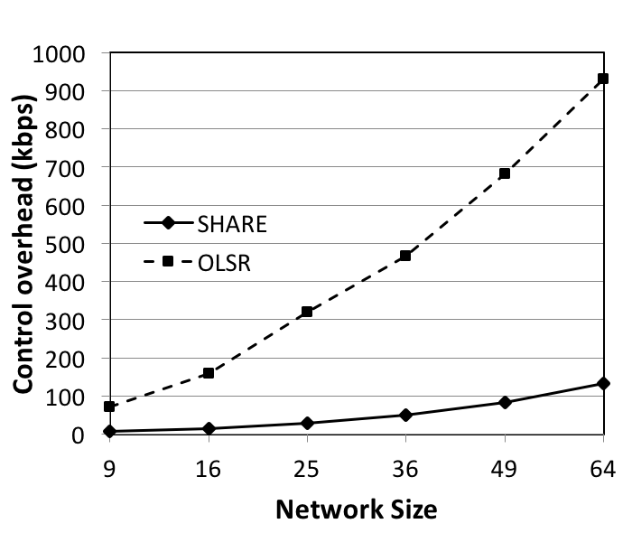
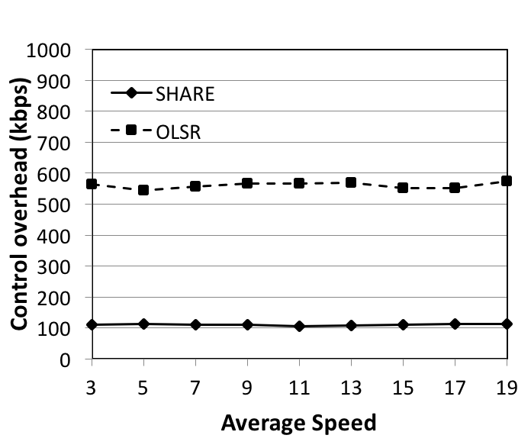
Overhead
7x more overhead than SHARE
Static grid
Gauss Markov, 60 nodes
Overhead of both protocols insensitive to speed when # of nodes is fixed
(m/s)
SHARE overhead grows much more slowly than OLSR overhead as network size increases
SHARE is much more scalable than OLSR

Slide 22
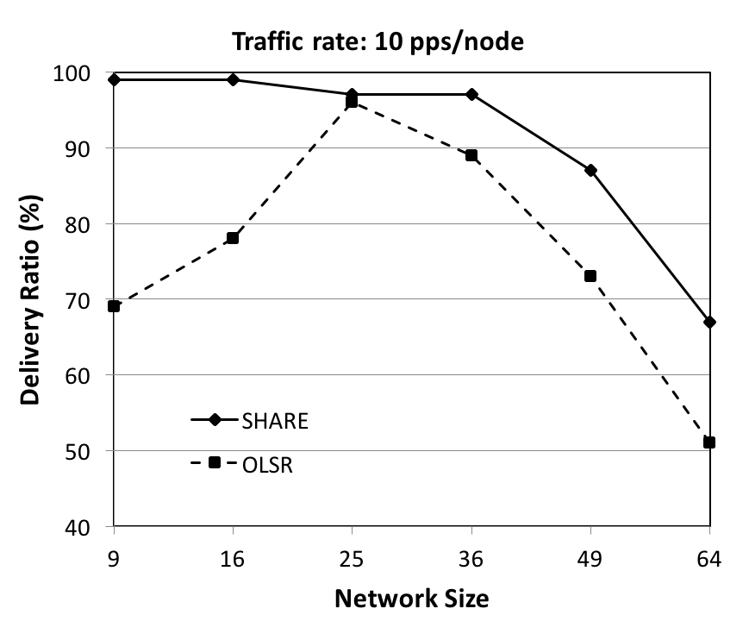
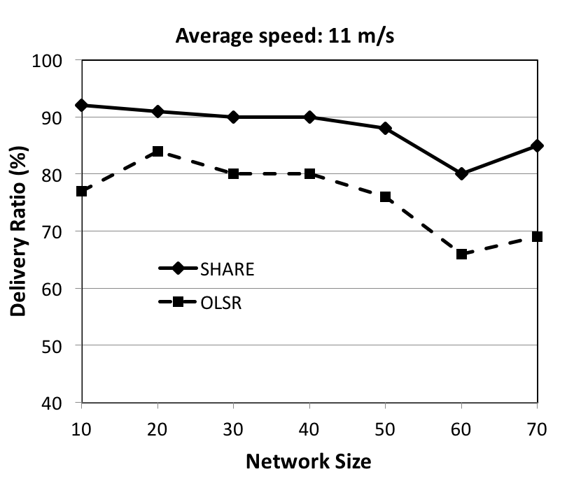
Delivery ratio
Static grid
Gauss Markov
23% more traffic
17% more traffic
For both static and mobile scenarios:
SHARE has higher delivery ratio than OLSR
Notes:
Increasing destinations measures the penalty of gradient control messages, which are proportional to the number of destinations.
Poor connectivity to destination

Slide 23
Delivery ratio
Static grid
Gauss Markov
As traffic gets close to all to all,
SHARE and OLSR converge
With mobility, OLSR performs significantly worse
Notes:
Increasing destinations measures the penalty of gradient control messages, which are proportional to the number of destinations.
Poor connectivity to destination

Slide 24
Roadmap
Motivation
SHARE protocol
Evaluation
Summary

Slide 25
SHARE summary
Scalable multi-hop routing unifying several ideas
proactive link state routing for local traffic
reactive gradient routing for non-local traffic
probabilistic truncation of GEM floods to reduce control overhead
replication of data packets for robustness against topology changes
flooding when no gradient or link state is found
Compared with OLSR on static and mobile topologies
SHARE delivers up to 31% more traffic using up to 7x less overhead
Future directions
further reduce overhead: link state messages, flood scoping, braiding
generalize to include delay tolerant forwarding
Thank you! Questions? vumanfredi@wesleyan.edu

Slide 26
References
[Ramanathan et al, 2010]
R. Ramanathan, R. Allan, P. Basu, J. Feinberg, G. Jakllari, V. Kawadia, S. Loos, J. Redi, C. Santivanez, and J. Freebersyser, “Scalability of mobile ad hoc networks: Theory vs practice,” in Military Communications Conference, 2010-MILCOM 2010. IEEE, 2010, pp. 493–498.

Slide 27
Proactive link state routing
Maintain 2-hop link state
use to route data packets with local destinations
limited control due to 2 hop scope
robustness benefits from alternative paths
also use to scope gradient control floods
Components
Heartbeat messages
transmitted exactly once
contain complete neighbor list for a node
Dijkstra’s algorithm
nodes use neighbor lists to compute all-pairs for neighborhood
Notes:
Most traffic is local: likely be routed using the local link state and only a small portion of the data traffic would be routed using the non-local gradient state

Slide 28
Braiding
A form of scoped flooding
replicate data packets over “‘braid” around shortest path
Braid
subgraph that includes shortest path between source and destination and all nodes and links within k-hops of shortest path
Link state and gradient state make braiding straightforward
nodes are already aware of alternative paths
if truncated GEM flood is too restrictive, too few paths to braid well
Packet time-to-live (TTL) constrains flood of braid packets
set initial packet TTL to maximum desired path length
node only forwards pkt if path length to dest. < pkt’s current TTL
generates at most k·TTL_{Max} packets
packet transmissions form a binary tree of height TTL_{Max}

Slide 29
Flooding
When no state found, flood data packet
Benefits
fallback mechanism when no route to destination known
enables mechanism for network wide broadcast
allows new nodes to easily join network and start forwarding data
provides redundancy for important transmissions when desired
Flood only as long as necessary
stop when packet reaches node with gradient or link state, or reaches destination
Scope using a TTL value that determines number of hops broadcast packet may travel before being dropped
Notes:
To accommodate instabilities in the network topology, both the link state and the gradient state provide alternative routes for data traffic, allowing SHARE to deliver data traffic even when the network topology is dynamic.
To provide additional redundancy for forwarding of data packets in dynamic networks, or when there is some potentially out-of-date state, SHARE uses scoped flooding of data packets over a braid around the shortest path on a per- flow basis [18], [14], [34], [20]. How wide to scope the braid is a configurable variable. In the absence of any link state or gradient state, such as in a highly dynamic network, SHARE seamlessly defaults to flooding of data packets, ensuring that traffic is delivered even when no routes exist. This flood, however, is not unconstrained: data packets are only flooded until they reach a node that contains gradient state or link state, or they reach the destination.

