Slide 1


Understanding Stateful vs Stateless Communication Strategies for Ad hoc Networks
Victoria Manfredi, Mark Crovella, Jim Kurose
MobiCom 2011

Slide 2



Problem
Many communication strategies: routing, flooding, DTN
But when is each appropriate?
Topology instability
Static: stateful strategies
work well
High mobility: stateful strategies can work poorly
Notes:
Static: stateful strategies work well (disseminate state then use to route)
High mobility: stateful strategies can work poorly (state out-of-date, useless when received, frequent dissemination wastes bandwidth)
Appropriate: maximizes goodput (unique data pkts delivered) depends on network and traffic characteristics

Slide 3
Problem
Many communication strategies: routing, flooding, DTN
But when is each appropriate?
When precisely do stateful vs stateless communication strategies maximize goodput?
Topology instability
Static: stateful strategies
work well
High mobility: stateful strategies can work poorly

Slide 4
Outline
1. Problem
  identify when stateful vs stateless strategies max goodput
2. Proposed framework
  introduce
  instantiate
  evaluate
3. Related work
4. Open questions
5. Summary
network models
data traces

Slide 5
Outline
1. Problem
  identify when stateful vs stateless strategies max goodput
2. Proposed framework
  introduce
  instantiate
  evaluate
3. Related work
4. Open questions
5. Summary
network models
data traces

Slide 6
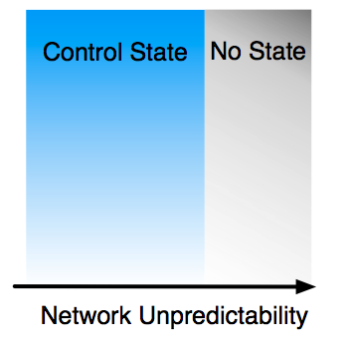
Proposed Framework
What state should communication strategies maintain?
Control state
  info about network
  e.g., what links/paths exist?
Valuable when network is predictable

Slide 7
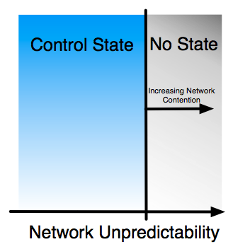
Proposed Framework
What state should communication strategies maintain?
Control state
  info about network
  e.g., what links/paths exist?
As contention (e.g., # of flows) increases, control state may be valuable even in less predictable network
Notes:
Cost of control state is amortized

Slide 8
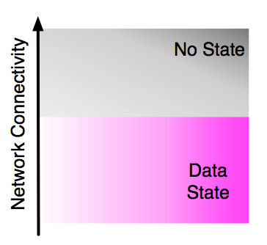
Proposed Framework
What state should communication strategies maintain?
Data state
  info about data pkts
  e.g., how long to buffer data pkts?
Valuable when network is not well-connected

Slide 9
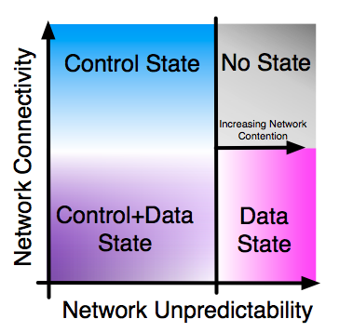
Proposed Framework
What state should communication strategies maintain?
Putting it all together
  4 classes of strategies

Slide 10
Proposed Framework
What state should communication strategies maintain?
Putting it all together
  4 classes of strategies
Routing
Flooding
Hybrid
DTN

Slide 11
Proposed Framework
What state should communication strategies maintain?
Putting it all together
  4 classes of strategies
  but, how to instantiate framework?
Routing
Flooding
Need empirical measures to quantify unpredictability, contention, connectivity
Hybrid
DTN

Slide 12
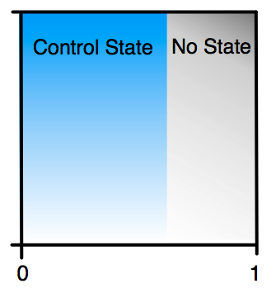
Instantiating the Framework
Unpredictability
  average link-up entropy, h
Contention
  number of flows in network, N
Connectivity
  probability arbitrary route exists, φ
h
0 1

Slide 13
Average Link-up Entropy, h
Network at time t Network at time t+i
(control state collected)
State of links that were up when control state last collected: link-up state
G_{t}
G_{t+i}
Link-up entropy, H(g_{t+i} | g_{t})
  g_{t}: arbitrary link up/down in G_{t}
Average link-up entropy, h
T
t
…
1 H(g_{t+1}|g_{t}) H(g_{t+2}|g_{t}) + …
Notes:
Quantifying the unpredictability in the changes of the states of the links
Conditional entropy of current link-up state given past state
Max entropy is one
Average over link-up entropies at each timestep
These measures capture the predictability of route information, such as how long routes remain stable.
As changes become more predictable (low h), utility of maintaining control state increases
T*H= update routing update interval in terms of entropy

Slide 14
Average Link-up Entropy, h
Network at time t Network at time t+i
(control state collected)
State of links that were up when control state last collected: link-up state
G_{t}
G_{t+i}
Link-up entropy, H(g_{t+i} | g_{t})
  g_{t}: arbitrary link up/down in G_{t}
Average link-up entropy, h
T
t
…
h = + +
1 H(g_{t+1}|g_{t}) H(g_{t+2}|g_{t}) + …
# of timesteps
Notes:
Quantifying the unpredictability in the changes of the states of the links
Conditional entropy of current link-up state given past state
Max entropy is one
Average over link-up entropies at each timestep
These measures capture the predictability of route information, such as how long routes remain stable.
As changes become more predictable (low h), utility of maintaining control state increases
T*H= update routing update interval in terms of entropy

Slide 15
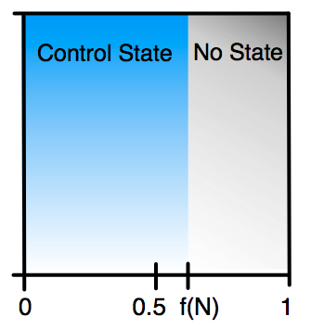
Instantiating the Framework
Unpredictability
  average link-up entropy, h
Contention
  number of flows in network, N
Connectivity
  probability arbitrary route exists, φ
Routing Flooding
S₁
S₁
h=0.5 f(N)
0 1
D₁
D₁
Notes:
If only one flow, little utility from control state
As N increases, utility of maintaining control state increases

Slide 16
Instantiating the Framework
Unpredictability
  average link-up entropy, h
Contention
  number of flows in network, N
Connectivity
  probability arbitrary route exists, φ
Routing Flooding
S₁
S₂
S₁
S₂
h=0.5 f(N)
1
1
1/2
1/2
0 1
D₁
D₂
D₁
D₂
Notes:
If only one flow, little utility from control state
As N increases, utility of maintaining control state increases

Slide 17
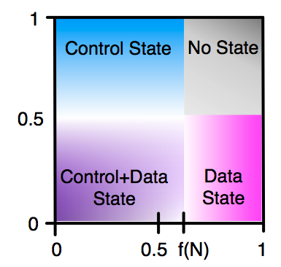
Instantiating the Framework
Unpredictability
  average link-up entropy, h
Contention
  number of flows in network, N
Connectivity
  probability arbitrary path exists, φ
1
End-to-end path likely to exist
φ=0.5
End-to-end path unlikely to exist
0
h=0.5 f(N)
0 1

Slide 18
Instantiating the Framework
Unpredictability
  average link-up entropy, h
Contention
  number of flows in network, N
Connectivity
  probability arbitrary path exists, φ
1
φ=0.5
0
h=0.5 f(N)
0 1

Slide 19
Instantiating the Framework
Unpredictability
  average link-up entropy, h
Contention
  number of flows in network, N
Connectivity
  probability arbitrary path exists, φ
1
How well does framework identify when stateful vs stateless strategy is appropriate?
φ=0.5
0
h=0.5 f(N)
0 1

Slide 20
Outline
1. Problem
  identify when stateful vs stateless strategies max goodput
2. Proposed framework
  introduce
  instantiate
  evaluate
3. Related work
4. Open questions
5. Summary
network models
data traces

Slide 21
Evaluating the Framework
How well does framework identify when stateful vs stateless strategy is appropriate?
Network models
  to evaluate entire parameter space (h, N, φ)
Data traces
  to check framework is useful for real networks
φ=0.5
h=0.5 f(N)
0 1

Slide 22
Network Model Simulations
Torus
Random Waypoint
  100 nodes
  1000m x 1000m area
  constant velocity, no pause
  perfect simulation
•••
  Link model
•••
1-p
q
p
•
•
•
•
•
•
•
•
•
•
•
•
up
down
•••
•••
1-q
…
Packet Transmission
  Packet received by all nodes reachable at timestep
  Link capacity of 1, can use for control or data pkt
?
Control Data
Communication Strategies
Routing: transmit pkt over shortest path
Flooding: flood pkt to all nodes reachable at current timestep
(Simplified) DTN: flood pkt to all nodes reachable within 2 timesteps
Notes:
To obtain a realistic timestep, we use a transmission rate of 11 Mbps and a packet size of 1500 bytes. This gives a timestep of
0.012 s log10(n) where n is the number of nodes in the network. Since we use 100 nodes, the timestep is 0.024s
Large p: links stay up long
Large q: links stay down long
Torus: randomly select src-dest pairs (senders) for each run
Torus: Compute goodput at each timestep
RWP: Sample network every timestep. If route(s) exists at sampled instant, assume exists for timestep

Slide 23
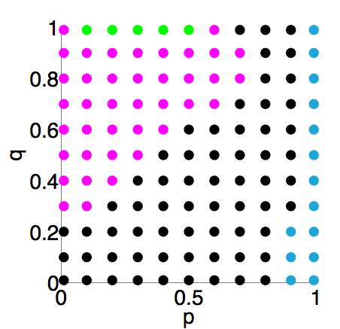
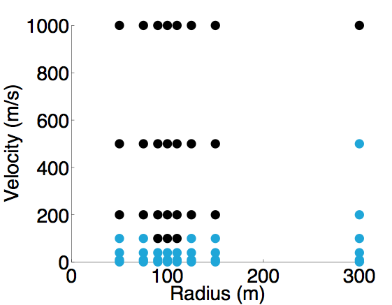
Results in Original Parameter Space (2 Flows)
Torus
RWP
Route Flood DTN None
No way to map where a strategy does well in one network model to another network model
Lack of DTN for RWP is due to simplified DTN strategy
Notes:
Each point represents a simulation run for a specific set of parameters. I’ve then highlighted the points of the same color.

Slide 24
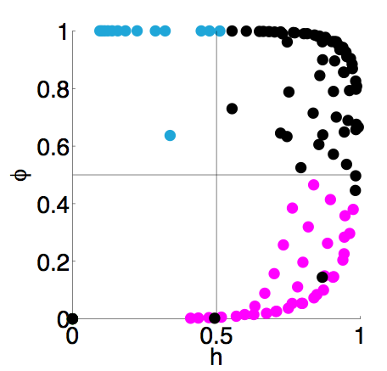
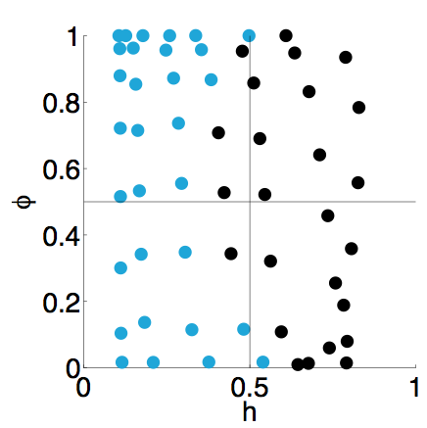
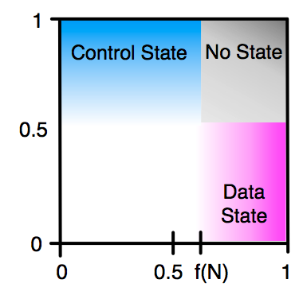
Results in Framework Space (2 Flows)
Torus
RWP
φ
φ
φ
h
h
h
Route Flood DTN None
Regions where different strategies maximize goodput are similar

Slide 25
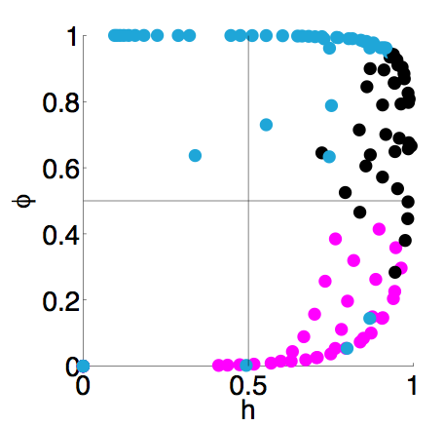
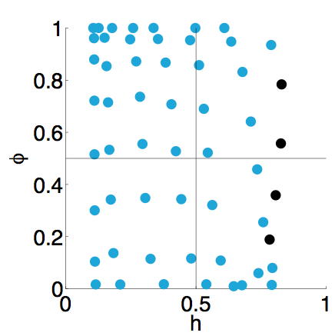
Results in Framework Space (7 Flows)
Torus
RWP
φ
φ
φ
h
h
h
Route Flood DTN None
Increasing network contention increases the probability that a control state strategy (routing) is appropriate
Framework consistently organizes decision space

Slide 26
Data Trace Simulations
Haggle
  Infocom06: 78 participants, 20 access points
  Infocom05: 41 participants
  Intel: 8 employees
  Cambridge: 12 grad students
DieselNet
  21 buses
  Add 2 hours after end of bus schedules for day
    assume buses in garage
    adjacent buses communicate
Discrete-time simulation
  1 timestep = 1 s
  Plot exponentially weighted moving average of measures (weight of 0.001)
Expect to be in data
state (DTN) region
Expect to finish in control state (routing) region
Notes:
Bluetooth sightings, imotes
Bus: 802.11
Weight of α = 0.001 to average in new values
Assume Ht(j)+i(j)jt(j) = 1 if no links exist in the network at timestep j.
We similarly compute a time-averaged phi at each timestep j using only the mobile nodes (i.e., we do not include connectivity to access points and external contacts).

Slide 27
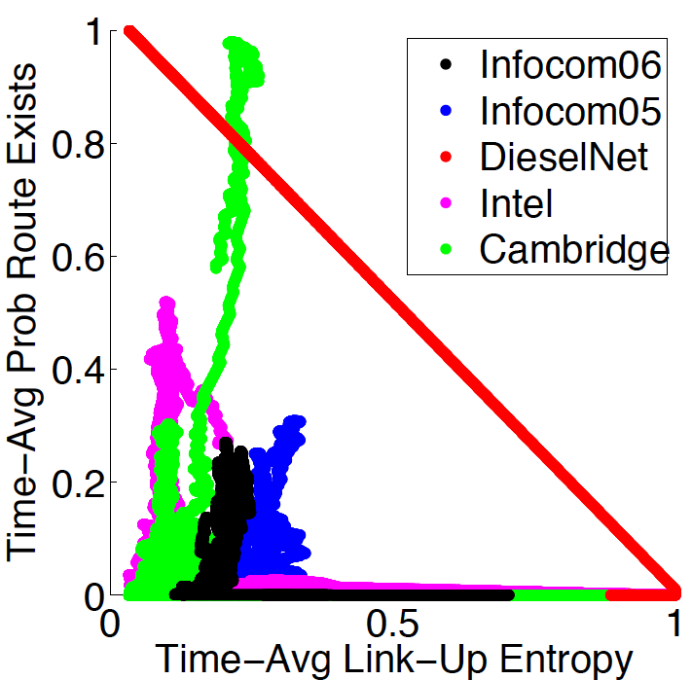
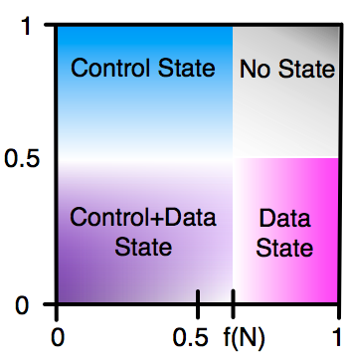
Analysis of Data Traces
What type of state should be maintained?
Cambridge
Intel
Time-Averaged φ
DieselNet
φ
Infocom06
Infocom05
Time-Averaged h
h
Surprisingly: control+data state strategies appropriate
Notes:
Surprisingly: control+data state strategies appropriate for majority of traces (even for traces typically thought of as DTN). But control+data state strategies not extensively explored in literature

Slide 28
Control+Data State Region
Low connectivity+low unpredictability
  few paths but paths are stable
Simple control+data state strategy
  if path exists to destination, use routing
  else use DTN forwarding via neighbors
Hybrid forwarding
Compare hybrid forwarding with routing and (more realistic) DTN forwarding
Pkt generation: flows between all node pairs, select random flow at each timestep and add pkt to queue
Notes:
Most traces spend most of their time in low connectivity and low unpredictability region
Few routes, but routes that exist are state

Slide 29
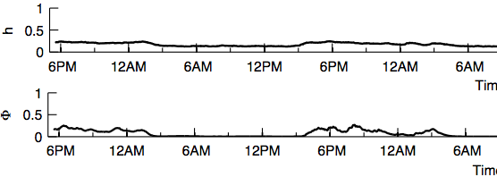
Infocom06 Trace
…
…

Slide 30
Infocom06 Trace
Control+Data
…
…

Slide 31
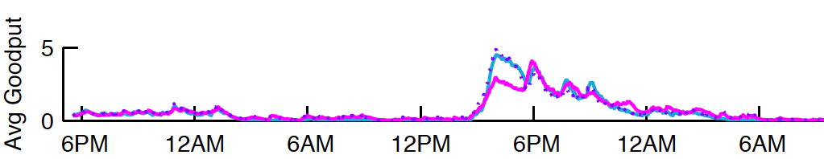
Infocom06 Trace
…
Control+Data
Routing : 152,491 packets delivered
DTN forwarding : 159,682
Hybrid forwarding : 168,059
…
…

Slide 32
Infocom06 Trace
…
Control+Data
Routing : 152,491 packets delivered
DTN forwarding : 159,682
Hybrid forwarding : 168,059
As predicted by framework, hybrid forwarding is most appropriate strategy for control+data state region
…
…

Slide 33
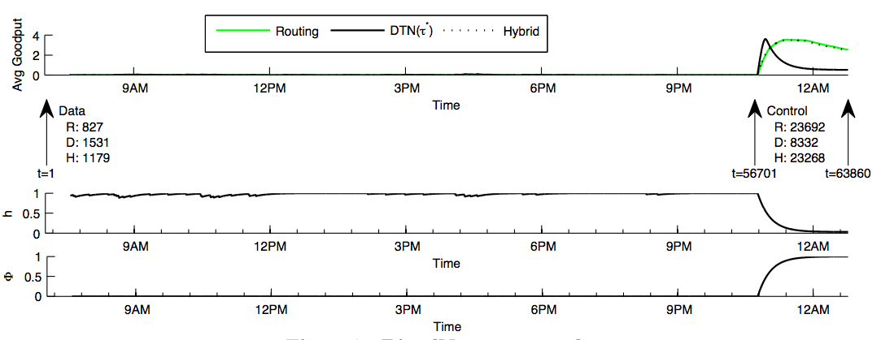
DieselNet Trace
…
…

Slide 34
DieselNet Trace
t=1 t=56701 t=63860
Data
Control
…
…

Slide 35
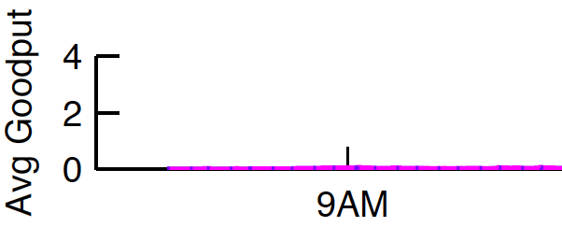
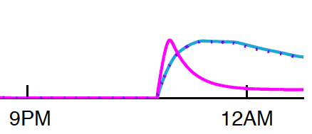
DieselNet Trace
…
t=1 t=56701 t=63860
Data
Control
Routing : 827 packets delivered
DTN forwarding : 1531
Hybrid forwarding : 1179
R: 23692
D: 8332
H: 23268
…
…

Slide 36
DieselNet Trace
As predicted by framework, DTN forwarding is most appropriate for data state region and routing is most appropriate for control state region
…
t=1 t=56701 t=63860
Data
Control
Other traces: strategies suggested by framework for the regions the traces fall into max goodput
Can always choose to switch to another region, e.g., by increasing transmission energy
Routing : 827 packets delivered
DTN forwarding : 1531
Hybrid forwarding : 1179
R: 23692
D: 8332
H: 23268
…
For hybrid forwarding strategy to always maximize goodput, need to tune so that
  ⇒ reduces to DTN forwarding in data state region
  ⇒ reduces to routing in control state region
…

Slide 37
Outline
1. Problem
  identify when stateful vs stateless strategies max goodput
2. Proposed framework
  introduce
  instantiate
  evaluate
3. Related work
4. Open questions
5. Summary
network models
data traces

Slide 38
Related Work
Organizing the space of strategies
  Ramanathan, Basu, Krisnan, 2007
    classify network based on level of connectivity, formalize routing mechanism needed for each class
  Chen, Borrel, Ammar, Zegura, 2011
    classify node pairs based on connectivity of path between nodes and path persistence, classify network based on proportion of nodes of each type
  Our focus: when to maintain state, what state to maintain
Hybrid-style strategies
  Ott, Kutscher, Dwertmann, 2006
    modify AODV to use DTN-capable nodes if no route to destination
  Chen, Zhao, Ammar, Zegura, 2007
    clustered DTNs: route within clusters, message ferry between clusters
  Whitbeck, Conan, 2010
    form groups then distance vector within group, DTN between groups
  Our focus: simple strategy to compare with routing, DTN
Notes:
Relating entropy and routing
[Wang, Abouzeid, 2008]: for link state routing, what is minimal rate at which to receive state updates in order to meet some error bound?
our focus: how does control overhead to maintain state impact whether routing vs flooding vs DTN forwarding appropriate?

Slide 39
Related Work
Organizing the space of strategies
  Ramanathan, Basu, Krisnan, 2007
    classify network based on level of connectivity, formalize routing mechanism needed for each class
  Chen, Borrel, Ammar, Zegura, 2011
    classify node pairs based on connectivity of path between nodes and path persistence, classify network based on proportion of nodes of each type
  Our focus: when to maintain state, what state to maintain
Hybrid forwarding strategies
  Ott, Kutscher, Dwertmann, 2006
    modify AODV to use DTN-capable nodes if no route to destination
  Chen, Zhao, Ammar, Zegura, 2007
    clustered DTNs: route within clusters, message ferry between clusters
  Whitbeck, Conan, 2010
    form groups then distance vector within group, DTN between groups
  Our focus: simple strategy to compare with routing, DTN
Notes:
Relating entropy and routing
[Wang, Abouzeid, 2008]: for link state routing, what is minimal rate at which to receive state updates in order to meet some error bound?
our focus: how does control overhead to maintain state impact whether routing vs flooding vs DTN forwarding appropriate?

Slide 40
Open Questions
Distributed algorithms to estimate measures
  gossip algorithms
  estimate local measures for different network regions
Adaptive forwarding strategies
  algorithm that maintains both control state and data state
    vary amount of state maintained both spatially and temporally
    reduces to routing, flooding, DTN forwarding when appropriate
Better measures of unpredictability, contention, connectivity?
  interference, energy, social ties, known (bus) schedules

Slide 41
Summary
Framework for understanding when/what state communication strategy should maintain
Instantiated
  (h,φ,N): measures that could be estimated in deployed network
Evaluated
  correctly and consistently organized decision space
  identified need for new class of communication strategies
Thank you! Questions?

Slide 42
Back-up slides

Slide 43
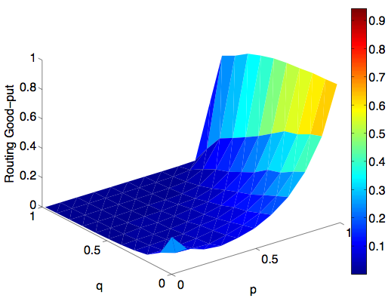
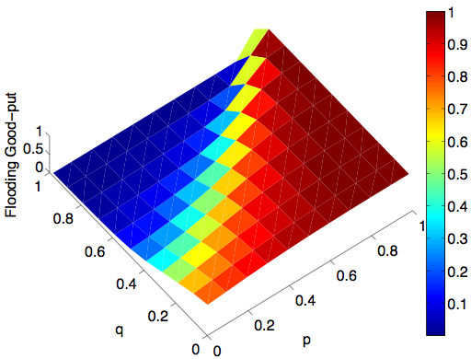
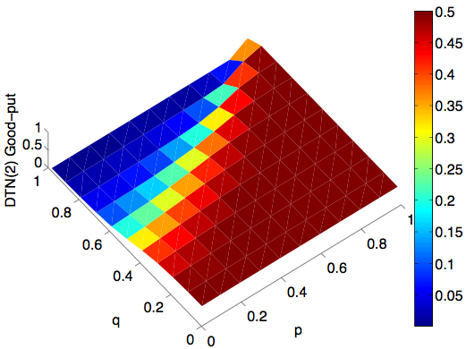
Torus: Average Goodput for One Sender
Routing
Flooding
DTN, τ=2
q
p
q
p
q
p
Percolation threshold
Percolation threshold
Routing goodput increases as links stay up longer or link changes become more predictable
Percolation: threshold for high/low flooding goodput
DTN goodput decays more slowly than flooding below percolation threshold
Notes:
Below percolation threshold: probability route exists is close to 0
Above percolation threshold: probability route exists is close to 1

Slide 44
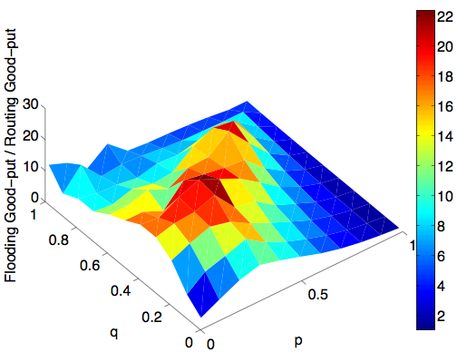
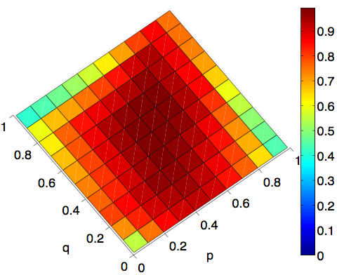
Torus: Goodput Relative to Flooding
Flooding / Routing
Avg Link-Up Entropy
q
p
q
p
Percolation threshold
Flooding has greatest gains relative to routing when link state highly uncertain (p≈q): high avg link-up entropy and at percolation threshold
Notes:
Flooding preferred when high network uncertainty

Slide 45
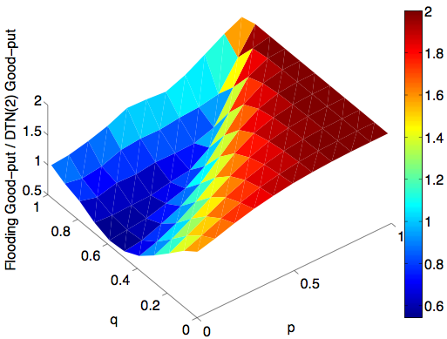
Torus: Goodput Relative to Flooding
Flooding / Routing
Flooding / DTN, τ=2
q
p
q
p
Percolation threshold
Flooding has greatest gains relative to routing when link state highly uncertain (p≈q): high avg link-up entropy and at percolation threshold
Flooding has smallest gains relative to DTN when end-to-end paths unlikely to exist: below percolation threshold

Slide 46
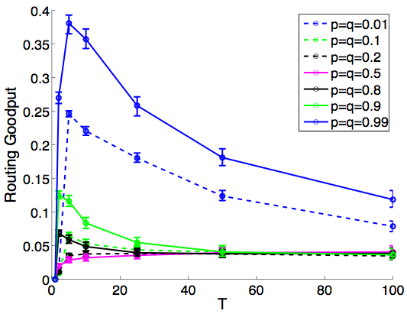
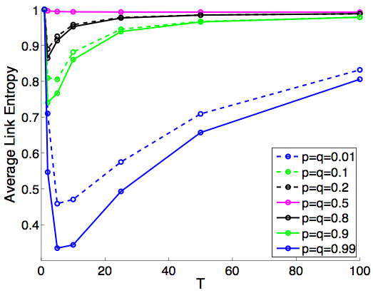
Torus: Average Link Entropy
p=q=0.5
p=q=0.9
p=q=0.99
p=q=0.01
p=q=0.01
p=q=0.99
p=q=0.9
p=q=0.5

Slide 47
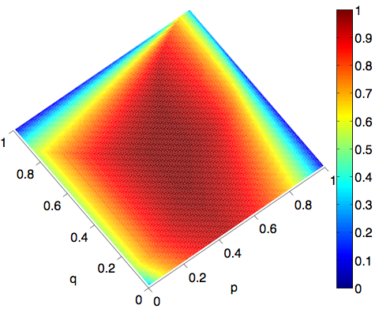
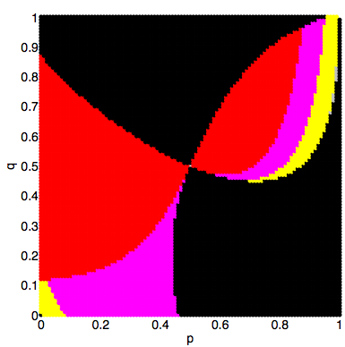
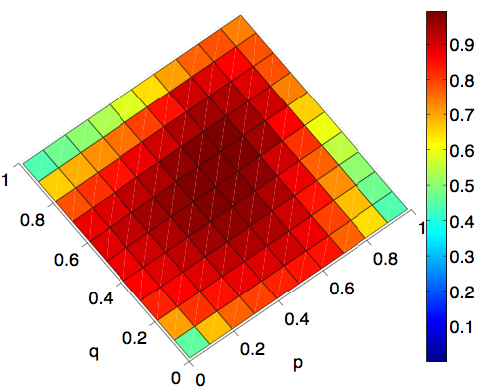
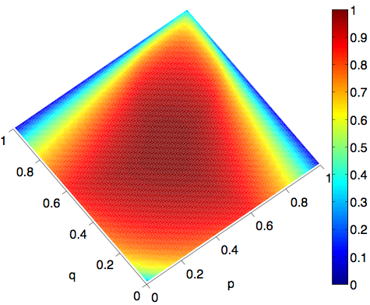
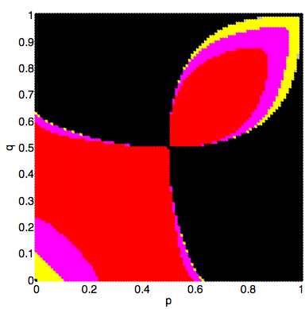
Torus: Average Link(-Up) Entropy
Simulation
Avg Link-Up Entropy
Theoretical
Avg Link-Up Entropy
Theoretical
T*
1
1
1
1
1
1
q
p
q
p
q
p
0 0
0 0
0 0

Slide 48
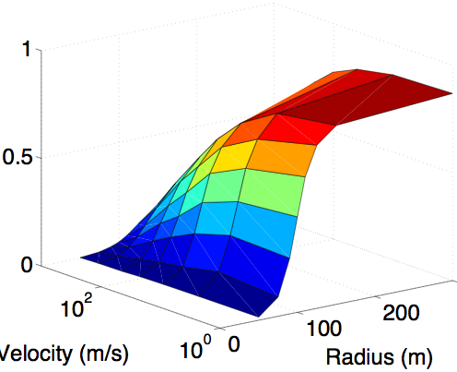
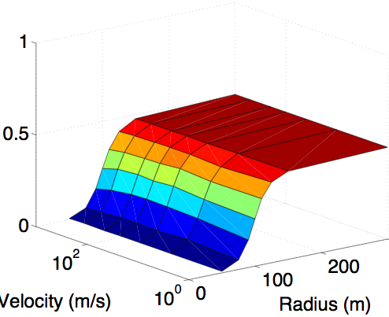
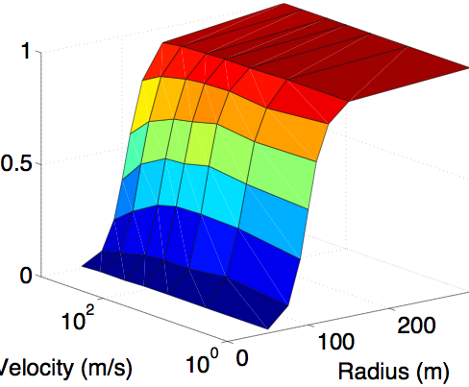
RWP: Average Goodput for One Sender
Routing
Flooding
DTN, τ=2
Velocity
(m/s)
Radius (m)
Velocity
(m/s)
Radius(m)
Velocity
m/s
Radius(m)
Percolation threshold
Percolation threshold
Routing goodput increases as links stay up longer or link changes become more predictable
Percolation: threshold for high/low flooding goodput
DTN goodput decays more slowly than flooding below percolation threshold

Slide 49
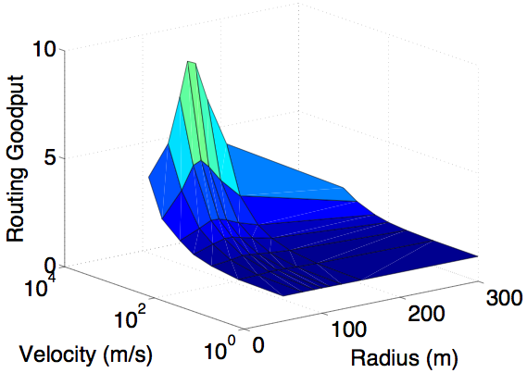
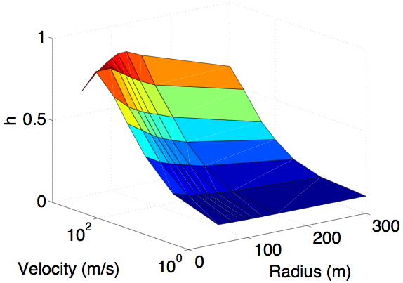
RWP: Goodput Relative to Flooding
Flooding / Routing
Avg Link-Up Entropy
Velocity (m/s)
Radius (m)
Velocity (m/s)
Radius (m)
Percolation threshold
Flooding has greatest gains relative to routing when link state highly uncertain (high velocity, smallish radius): high avg link-up entropy and at percolation threshold
Notes:
Flooding preferred when high network uncertainty

Slide 50
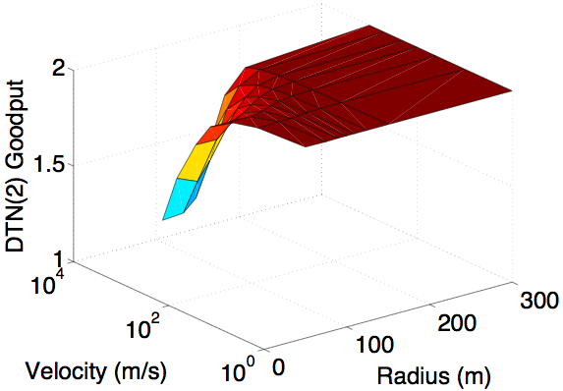
RWP: Goodput Relative to Flooding
Flooding / Routing
Flooding / DTN, τ=2
Velocity (m/s)
Radius (m)
Velocity (m/s)
Radius (m)
Percolation threshold
Flooding has greatest gains relative to routing when link state highly uncertain (high velocity, smallish radius): high avg link-up entropy and at percolation threshold
Flooding has smallest gains relative to DTN when end-to-end paths unlikely to exist: below percolation threshold

Slide 51
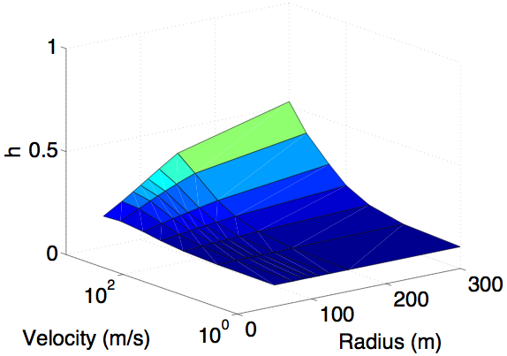
RWP: Average Link-Up Entropy
Up Links Only Up Links and Down Links

