Slide 1
Quantifying Unlinkability in Multi-hop Wireless Networks
Victoria Manfredi, Cameron Donnay Hill
MSWiM
November 17, 2020

Slide 2
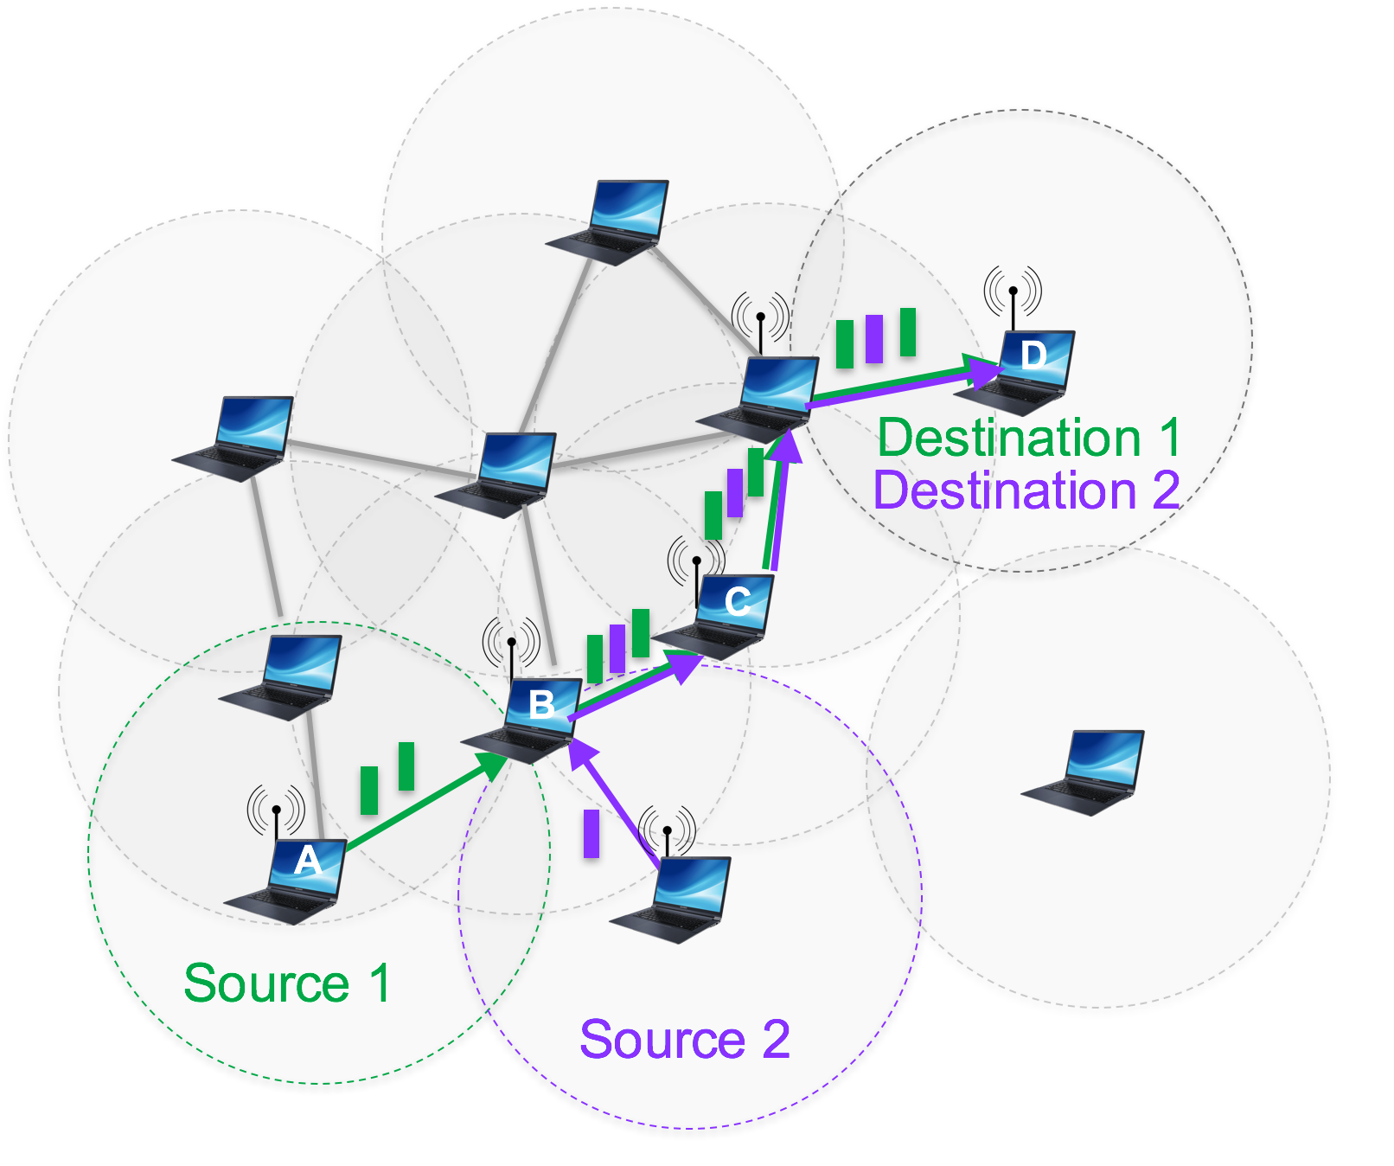


Consider a multi-hop wireless network
Devices relay traffic for each other rather than use infrastructure
Notes:
Inferring (un)linkability in multi-hop networks
focus is on-demand routing protocols, hard to generalize to our scenario
Liu, Zhang, Shi, Zhang. Traffic inference in anonymous manets. (SECON, 2010)
Qin, Huang, Li. STARS: A statistical traffic pattern discovery system for MANETs. (IEEE Transactions on Dependable and Secure Computing, 2013)
Inferring (un)linkability in mix networks
discrete probabilistic model using user selected mix path lengths and mixing
Troncoso, Danezis. The bayesian traffic analysis of mix networks. (CCS, 2009)
Our model
Kalman filter
flows are hidden state, link transmissions are observations
focus is impact of # of flows, connectivity, link type, multihop routing strategy
Network tomography
focus on Internet traffic, ignore traffic obfuscation
Vardi. Network tomography: Estimating source-destination traffic intensities from link data. (Journal of the American statistical association, 1996)
Soule, Salamatian, Nucci, Taft. Traffic matrix tracking using kalman filters. (SIGMETRICS, 2005)
Our model
focus on Internet traffic, ignore traffic obfuscation
Vardi. Network tomography: Estimating source-destination traffic intensities from link data. (Journal of the American statistical association, 1996)
Soule, Salamatian, Nucci, Taft. Traffic matrix tracking using kalman filters. (SIGMETRICS, 2005)
Our model
considers traffic obfuscation, multi-hop routing
infer individual flows rather than aggregations
assumes true flow distribution is never known

Slide 3
Lack of infrastructure
Makes multi-hop networks not just easier to deploy but also increases privacy: devices avoid infrastructure that may be monitored, users better control distribution of their data
Notes:
Inferring (un)linkability in multi-hop networks
focus is on-demand routing protocols, hard to generalize to our scenario
Liu, Zhang, Shi, Zhang. Traffic inference in anonymous manets. (SECON, 2010)
Qin, Huang, Li. STARS: A statistical traffic pattern discovery system for MANETs. (IEEE Transactions on Dependable and Secure Computing, 2013)
Inferring (un)linkability in mix networks
discrete probabilistic model using user selected mix path lengths and mixing
Troncoso, Danezis. The bayesian traffic analysis of mix networks. (CCS, 2009)
Our model
Kalman filter
flows are hidden state, link transmissions are observations
focus is impact of # of flows, connectivity, link type, multihop routing strategy
Network tomography
focus on Internet traffic, ignore traffic obfuscation
Vardi. Network tomography: Estimating source-destination traffic intensities from link data. (Journal of the American statistical association, 1996)
Soule, Salamatian, Nucci, Taft. Traffic matrix tracking using kalman filters. (SIGMETRICS, 2005)
Our model
focus on Internet traffic, ignore traffic obfuscation
Vardi. Network tomography: Estimating source-destination traffic intensities from link data. (Journal of the American statistical association, 1996)
Soule, Salamatian, Nucci, Taft. Traffic matrix tracking using kalman filters. (SIGMETRICS, 2005)
Our model
considers traffic obfuscation, multi-hop routing
infer individual flows rather than aggregations
assumes true flow distribution is never known

Slide 4
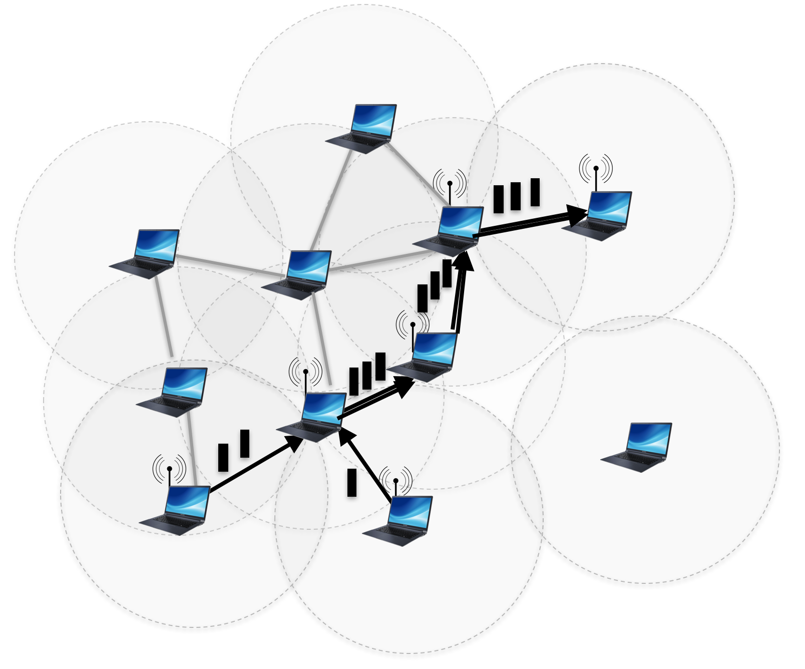

But what about external attacks?
Wireless traffic patterns may indicate which devices are critical to network functionality, even if link transmissions are re-encrypted. E.g., commanders, sources, sinks.
Actual network state
What adversary observes
Notes:
military network: adversary can jam or destroy commander devices
sensor network : adversary can jam/delay traffic between sources and sinks
emergency monitoring: adversary can delay/prevent critical information from reaching its destination
Inferring (un)linkability in multi-hop networks
focus is on-demand routing protocols, hard to generalize to our scenario
Liu, Zhang, Shi, Zhang. Traffic inference in anonymous manets. (SECON, 2010)
Qin, Huang, Li. STARS: A statistical traffic pattern discovery system for MANETs. (IEEE Transactions on Dependable and Secure Computing, 2013)
Inferring (un)linkability in mix networks
discrete probabilistic model using user selected mix path lengths and mixing
Troncoso, Danezis. The bayesian traffic analysis of mix networks. (CCS, 2009)
Our model
Kalman filter
flows are hidden state, link transmissions are observations
focus is impact of # of flows, connectivity, link type, multihop routing strategy
Network tomography
focus on Internet traffic, ignore traffic obfuscation
Vardi. Network tomography: Estimating source-destination traffic intensities from link data. (Journal of the American statistical association, 1996)
Soule, Salamatian, Nucci, Taft. Traffic matrix tracking using kalman filters. (SIGMETRICS, 2005)
Our model
focus on Internet traffic, ignore traffic obfuscation
Vardi. Network tomography: Estimating source-destination traffic intensities from link data. (Journal of the American statistical association, 1996)
Soule, Salamatian, Nucci, Taft. Traffic matrix tracking using kalman filters. (SIGMETRICS, 2005)
Our model
considers traffic obfuscation, multi-hop routing
infer individual flows rather than aggregations
assumes true flow distribution is never known

Slide 5
Our focus is on unlinkability
... aka source-destination anonymity or relationship anonymity: how well can we identify source-destination pairs from only anonymized link transmissions?
Passive global eavesdropper
?
Actual network state
What adversary observes
Notes:
observes packet transmissions but cannot parse or jam or inject packets

Slide 6
What increases unlinkability?

Slide 7
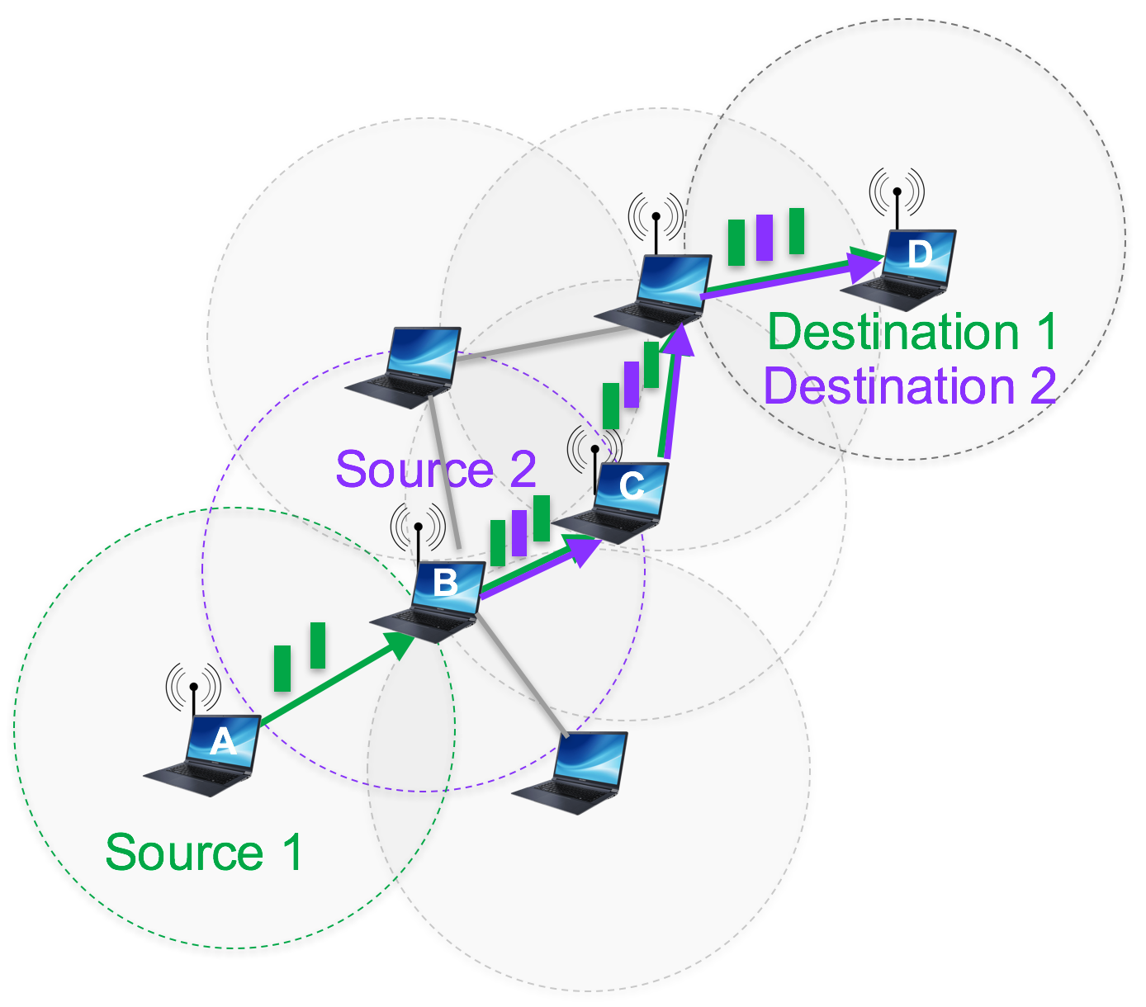
What increases unlinkability?
Anything that reorders packets or obscures sources and destinations
Multi-hop routing
  more flows enables interleaving more packets
Incoming traffic need not match outgoing traffic at devices
Network connectivity, routing strategy, flows present impact traffic mismatch
Notes:
Or just seems to

Slide 8


What increases unlinkability?
Anything that reorders packets or obscures sources and destinations
Multi-hop routing
  more flows enables interleaving more packets
Wireless links
Broadcast links
Multiple packet copies
A B C
A and C are unaware of each other and so do not realize they are causing interference at B
Wireless MAC must handle collisions: random retransmissions interleaved with transmissions from other devices
Notes:
2.2.2 Wireless links. The MAC protocol used to access a wireless link typically has a component introducing random delays. Because wireless transmissions interfere, a device may attempt (typically up to 7) re-transmissions of the same packet at random backo times,
interleaved with transmissions from other devices, to cope with collisions. Thus, the dwelling time of packets at devices is variable.
2.2.3 Broadcast transmissions. Wireless transmissions may be uni- cast (unidirectional) or broadcast (omnidirectional). When a wire- less device transmits a packet using a broadcast transmission, all devices within range receive the transmission, not just the intended recipient. A receiving device then determines whether it is the in- tended recipient by checking the packet destination address. Thus, to an outside observer, which neighbor device is the intended recip- ient may be unclear, assuming no control trac such as acknowl- edgements are sent upon receipt.
2.2.4 Network connectivity. Well-connected topologies should sup- port higher trac mixing and thus unlinkability. In our simulations in Sec. 6, we measure network connectivity using algebraic connec- tivity, 2, which is dened as the second-smallest eigenvalue of the normalized Laplacian matrix of a graph [6]. The larger the value of 2, the more well-connected is the graph.
2.2.5 Link dynamics. Due to wireless interference, fading, or mo- bility the network connectivity may change, and consequently, the pattern of wireless transmissions observed by an adversary may change, even if the underlying set of ows stays the same.
2.2.6 Multiple packet copies. Flow correlation attacks typically assume a single copy of a packet. To cope with link dynamics, a multi-hop routing strategy may transmit multiple copies of a packet.

Slide 9
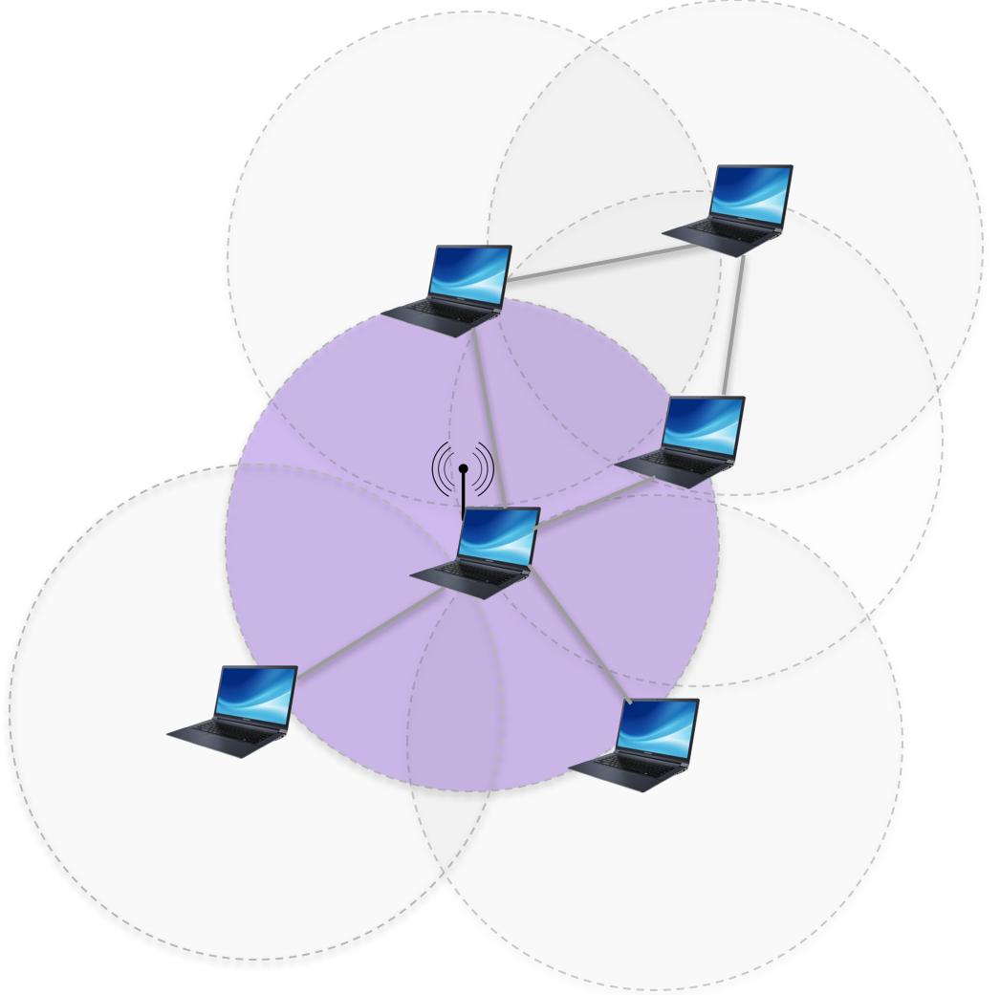
What increases unlinkability?
Anything that reorders packets or obscures sources and destinations
Multi-hop routing
  more flows enables interleaving more packets
Wireless links
Broadcast transmissions
  All devices within range of the sender must be considered as potentially the intended recipient

Slide 10
What increases unlinkability?
Anything that reorders packets or obscures sources and destinations
Multi-hop routing
  more flows enables interleaving more packets
Wireless links
Broadcast transmissions
Link dynamics
Because of link dynamics, the pattern of wireless transmissions observed by an adversary may change, even if underlying flows stays the same

Slide 11
What increases unlinkability?
Anything that reorders packets or obscures sources and destinations
Multi-hop routing
  more flows enables interleaving more packets
Wireless links
Broadcast transmissions
Link dynamics
Multiple packet copies
Due to wireless interference or mobility, multi-hop routing may forward multiple packet copies

Slide 12
What increases unlinkability?
Anything that reorders packets or obscures sources and destinations
Multi-hop routing
  more flows enables interleaving more packets
Wireless links
Broadcast transmissions
Link dynamics
Multiple packet copies
Goal: quantify impact on traffic mixing and thus unlinkability in different network scenarios

Slide 13
Quantifying unlinkability
Existing unlinkability metrics
  Köpsell, Steinbrecher. Modeling unlinkability. (PETs, 2003)
  Shmatikov, Wang. Measuring relationship anonymity in mix networks. (WPES, 2006)
  Fischer, Katzenbeisser, Eckert. Measuring unlinkability revisited. (WPES, 2008)
  Huang. Unlinkability measure for IEEE 802.11 based MANETs. (IEEE Transactions on Wireless Communications, 2008)
  Moe. Quantification of anonymity for mobile ad hoc networks. (Electronic Notes in Theoretical Computer Science, 2009)
  Problem: not easy to compute these metrics as function of network features
Network tomography
  Vardi. Network tomography: Estimating source-destination traffic intensities from link data. (Journal of the American statistical association, 1996)
  Soule, Salamatian, Nucci, Taft. Traffic matrix tracking using Kalman filters. (ACM SIGMETRICS Performance Evaluation Review, 2005)
  Problem: don’t consider traffic obfuscation, multi-hop routing, or network dynamics
This work: derive new unlinkability metric, quantify how different network features impact unlinkability

Slide 14
How do we quantify unlinkability?

Slide 15
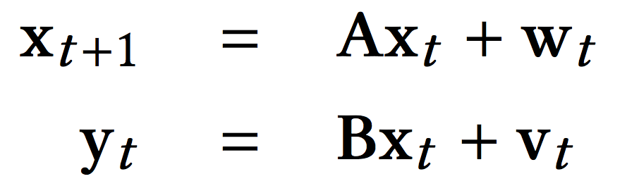
Kalman filter to infer distribution of flows
Model (linear) dynamics of an object (i.e., flows) over time
Hidden state of flows at time t+1
Noisy observations of flows at time t
Total traffic and arrival rate on each flow up to time t
Total transmissions on each link up to time t
x_{t} = [flow_{1,1}, flow_{1,2}, …, flow_{N,N} ,
rate_{1,1}, rate_{1,2}, …, rate_{N,N}]
y_{t} = [link_{1,1}, link_{1,2}, …, link_{N,N}]
Notes:
Observations are linear function of state plus Gaussian noise
How does Kalman filter model state and observation change?

Slide 16
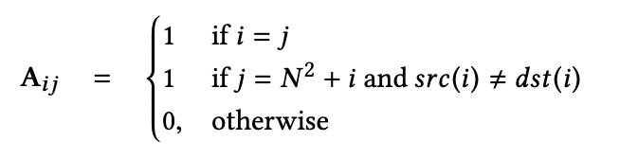
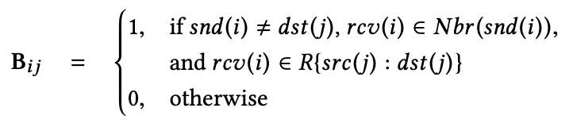
Modeling flow dynamics
Transition matrix, A, transforms state at time t to state at time t+1
Observation matrix, B, transforms state at time t to observations at time t
Traffic never switches flows
Traffic arrivals on flows
Sender is not destination of flow
Receiver is neighbor of sender
Receiver is on route used by assumed routing strategy
Link i
Flow j
For each possible sender, B gives next receiver as determined by routing and topology
Notes:
assume state transitions, A, follow shortest path routing
Observation matrix, B, maps flow i state at time t to link j transmissions at time t
For each link j and flow i, for each possible sending device snd(j), B gives next receiving device rcv(j) as determined by routing and topology

Slide 17
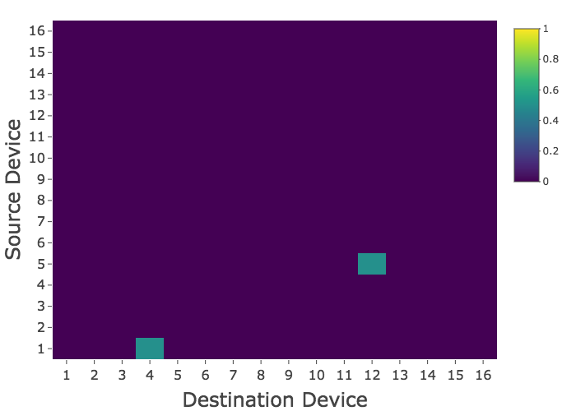

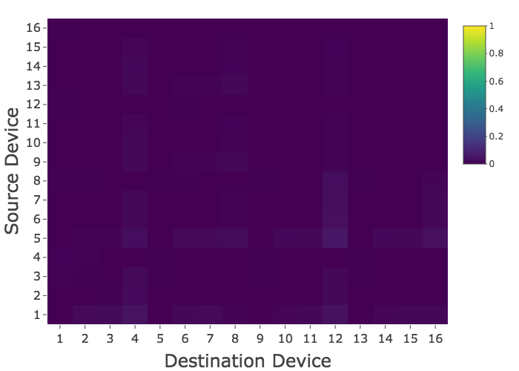
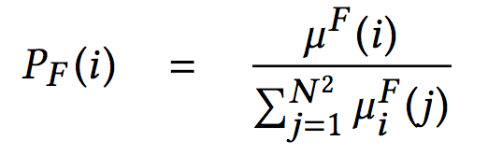
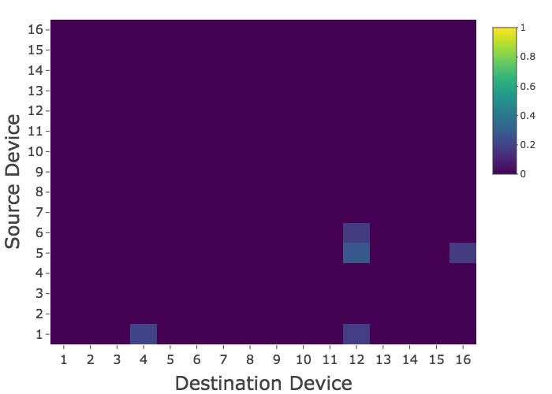
Computing the flow distribution
2 Flows, Lattice
True flow distribution, P_{T}
Compute likelihood
Normalize to get flow distribution
Compute teb given
Gaussian: let 𝜇^{F} be mean
𝜇^{F} = [flow_{1,1}, flow_{1,2}, …, flow_{N,N}]
Inferred flow distribution, P_{F}
Renormalized
Renormalize again to focus on most probable states
Notes:
As the network size, N , increases, the probability weight gets more and more finely dispersed over the possible states under consideration. We therefore renomalize the distribution PF once more focusing on the top 2F most probable states, where F is the actual number of ows in the network. Knowing F is strictly not necessary and any cuto point to identify the inferred most likely ows could be used. To identify these top 2F most likely states, we sort the probabilities and nd the value, minF , at index 2F in this sorted list. We then set all probabilities less than minF to zero and then renormalize PF .

Slide 18
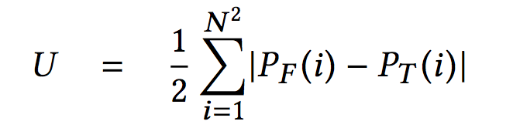
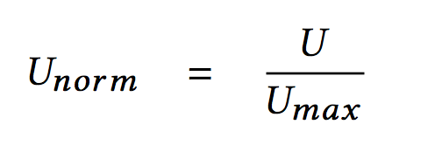

Computing unlinkability
Compute total variation distance between P_{T} and P_{F}
Renormalize by U_{max}, unlinkability when P_{F} is uniform random distribution
Ex: 2 flows, line
P_{T}
P_{F}
U_{norm} = 0.579

Slide 19
Simulation results

Slide 20
Simulation set-up
Line Lattice Geometric Random Complete
Traffic
  randomly choose F data flows with replacement, Poisson arrivals with λ = 0.5
Routing
  probability 𝜑: forward packet to shortest path next hop
  probability 1-𝜑: forward packet to random next hop
Link dynamics
1-p
p
Up
Down
q
1-q
Notes:
Link access
discrete time: one timestep sufficiently long for every device to transmit one packet
T = 200 timesteps
Until packet reaches its destination

Slide 21
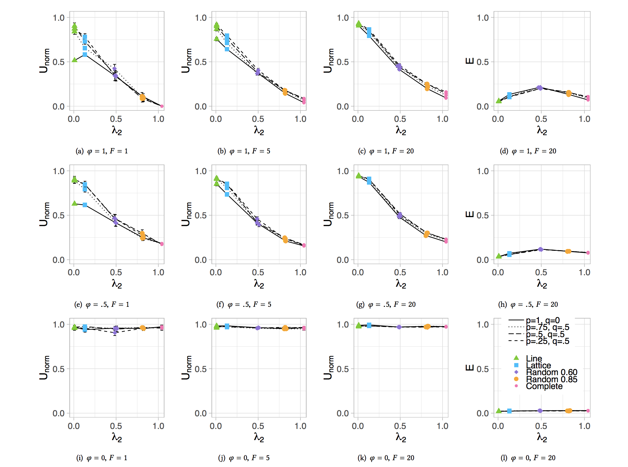
Impact of multi-hop routing on unlinkability
Line
Lattice
Random 0.60
Random 0.85
Complete
Unicast
No randomness
F=1
𝜌=1
p=1, q=0
Multi-hop routing increases unlinkability as long as paths are more than 1 hop long
Line ⇒ paths are up to N-1 hops long
Complete ⇒ paths are 1 hop long
Algebraic connectivity, λ₂
2nd smallest eigenvalue of normalized Laplacian matrix of graph
as λ₂ increases so does connectivity
Notes:
F=20
Unlinkability is not always 0 with unicast, 1 flow and no randomness
Why? Multi-hop routing
Algebraic connectivity, λ₂
2nd smallest eigenvalue of normalized Laplacian matrix of graph
as λ₂ increases so does connectivity

Slide 22
Impact of link type on unlinkability
Line
Lattice
Random 0.60
Random 0.85
Complete
Unicast
Broadcast
No randomness
F=1 F=20
F=1 F=20
𝜌=1
p=1, q=0
Unicast scenarios generally have lower unlinkability than broadcast scenarios
Notes:
F=20
Unlinkability is not always 0 with unicast, 1 flow and no randomness
Why? Multi-hop routing
Algebraic connectivity, λ₂
2nd smallest eigenvalue of normalized Laplacian matrix of graph
as λ₂ increases so does connectivity

Slide 23
Impact of routing randomness on unlinkability
Line
Lattice
Random 0.60
Random 0.85
Complete
Unicast
Broadcast
No randomness
F=1 F=20
F=1 F=20
𝜌=1
𝜌=0.5
𝜌=0
p=1, q=0
More randomness
Routing randomness increases unlinkability
Notes:
F=20
Unlinkability is not always 0 with unicast, 1 flow and no randomness
Why? Multi-hop routing
Algebraic connectivity, λ₂
2nd smallest eigenvalue of normalized Laplacian matrix of graph
as λ₂ increases so does connectivity

Slide 24
Impact of network topology on unlinkability
Line
Lattice
Random 0.60
Random 0.85
Complete
Unicast
Broadcast
No randomness
F=1 F=20
F=1 F=20
𝜌=1
𝜌=0.5
p=1, q=0
Increasing connectivity
Increasing connectivity
… decreases unlinkability for unicast links
… increases unlinkability for broadcast links
Notes:
F=20
Unlinkability is not always 0 with unicast, 1 flow and no randomness
Why? Multi-hop routing
Algebraic connectivity, λ₂
2nd smallest eigenvalue of normalized Laplacian matrix of graph
as λ₂ increases so does connectivity

Slide 25
Impact of link dynamics on unlinkability
Line
Lattice
Random 0.60
Random 0.85
Complete
Unicast
Broadcast
No randomness
F=1 F=20
F=1 F=20
𝜌=1
𝜌=0.5
p=1, q=0
p=.75, q=.5
p=.50, q=.5
p=.25, q=.5
When low connectivity, unicast link dynamics increase unlinkability
When low connectivity, broadcast link dynamics increase unlinkability but when high connectivity, broadcast link dynamics decrease unlinkability
A lattice topology consistently supports high unlinkability
Notes:
Lattice has higher anonymization efficiency than lattic
The dotted and dashed lines in Figs. 4 and 5 are for scenarios when links are dynamically changing.
Essentially, when the network is sparsely connected, unicast link dynamics may prevent a device from making a transmission,
and as a result, can change the probabilities that packets are destined to that device or its neighbors.
when a given device makes repeated broadcast transmissions over time, if diffrent subsets of the component unicast links to the device’s neighbors are down due to link dynamics, then this can give information about which neigh-bor a transmission is intended for.
When the network is sparsely connected, the broadcast scenario is similar to the unicast scenario, with link dynamics potentially preventing a device from making any transmission.

Slide 26
Summary and future work

Slide 27
Summary and future work
Quantify how different network characteristics impact unlinkable communications in multi-hop networks
Focus:
Traffic mixing due to multi-hop routing, broadcast, and link dynamics rather than at devices
Future work:
Scaling to larger networks
Impact of mobility, link layer
Active adversary
Protocols for anonymous communication
  vumanfredi@wesleyan.edu
  https://victoriamanfredi.com
?? || /**/
Notes:
In this work, we have analyzed the unlinkability achievable when tra c mixing is due to packet and ow interleaving from multi-hop routing and broadcast transmissions, rather than mixing at individual devices. To do this, we formulated a Kalman lter adversary who passively observes all packet transmissions that occur in a multi-hop network in which devices also act as anonymizing routers. The adversary uses these transmissions to compute a probability distribution over the possible ows present in the network. From this ow dis- tribution we derived an unlinkability metric that we analyzed in simulation. We showed that (1) depending on the number of randomly chosen ows present in the network, less routing randomness is needed to achieve the same level of unlink- ability, (2) broadcast transmissions are primarily bene cial when the topology is well-connected, (3) for unicast links, as network connectivity increases, unlinkability decreases, (4) for broadcast links, as network connectivity increases, un- linkability increases, but only to a point, and (5) regardless of unicast or broadcast link type, more well-connected topologies
are able to achieve the same level of unlinkability with fewer transmissions per packet delivered.

Slide 28
Unicast
Notes:
Broadcast

Slide 29
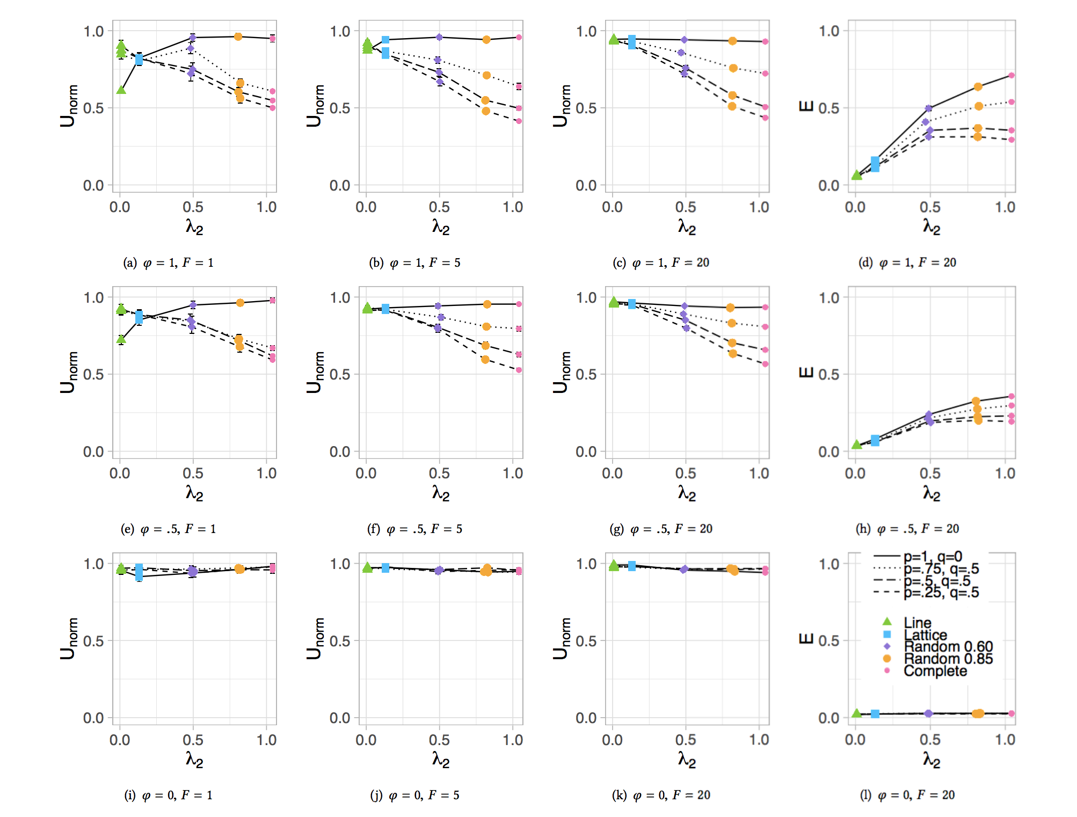
Broadcast
Notes:
Unicast

Slide 30
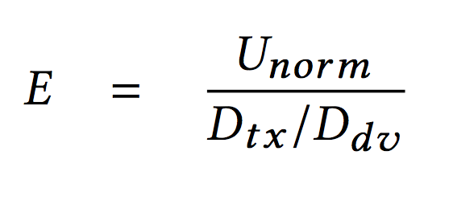
What is unlinkability gain per transmission?
More transmissions may increase unlinkability
  but unlinkability gain per transmission made may be small
Anonymization efficiency, E
  estimates unlinkability gain per transmission per packet delivered
D_{tx}
D_{dv}
# of data packets transmitted
# of data packets delivered
Notes:
Quantify gains in unlinkability at cost of transmissions

Slide 31
Our network and adversary assumptions
Multi-hop wireless network
  devices are also anonymizing routers but do not mix traffic
  i.e., what unlinkability do we get for “free”?
Adversary is passive global eavesdropper
  observes packet transmissions
  cannot parse packets
  cannot jam or inject packets
Compute (un)linkability
  use packet transmissions on links to infer probability distribution over possible flows (i.e., source-destination pairs)
Notes:
passively observes packet transmissions on every link
cannot parse packet headers or payload data
cannot jam transmissions or inject packets

Slide 32
Computing unlinkability overview
Use Kalman filter to infer probability distribution over flows, P_{F}, given observed link transmissions
Renormalize P_{F} to focus on most probable states
Compute total variation distance between P_{F} and true flow distribution, P_{t}, to obtain measure of unlinkability

